Slide 1

Organ donation and transplantation
Swiss National Foundation for Organ Donation and Transplantation
Bern | 2026
info@swisstransplant.org
Gaëtan, liver recipient

Slide 2
Objectives of the presentation
Home
The Swisstransplant Foundation
Transplantation Act
Facts and figures
Organ donation procedure
Questions

Slide 3
Swisstransplant
01
Swisstransplant
Structure and organization

Slide 4

Swisstransplant – Swiss National Foundation for Organ Donation and Transplantation
Swisstransplant Foundation
1985
Creation of the Foundation in Geneva
Bern
2007
Allocation of organs to recipients in accordance with the law
2009
Allocation of benefits by the Swiss Conference of the Cantonal Ministers of Public Health
Coordination and development of organ donation at the national level
Mandated by the Federal Office of Public Health (FOPH) as the national allocation service
Management of the waiting list
Compensation in the organ donation process/financing of hospital staff (H+/SVK)

Slide 5
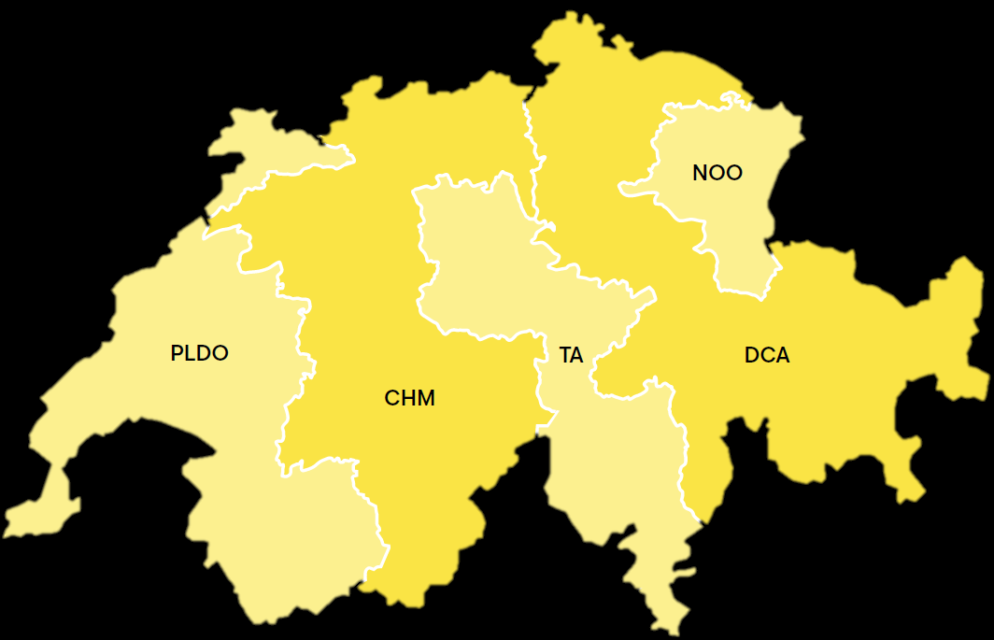




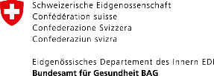

Collaboration
Partners
Organ donation
Organ donation networks
Transplantation
Transplant centres
International collaboration
Basel
Zürich
St.Gallen
FOEDUS – European Organ Exchange Organisation
CD-P-TO – European Committee on Organ, Tissue and Cell Transplantation
Bern
Lausanne
Genf

Slide 6
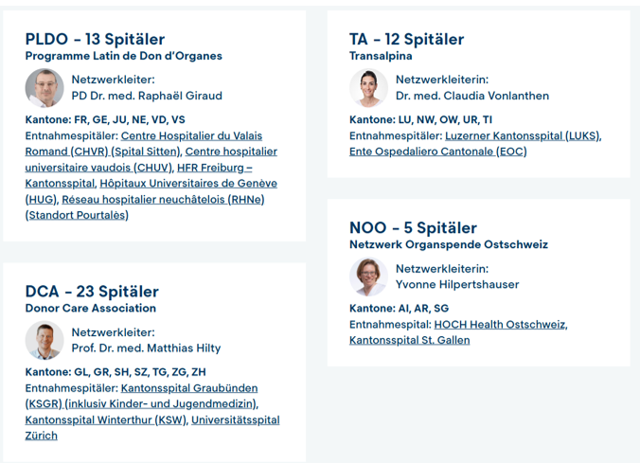
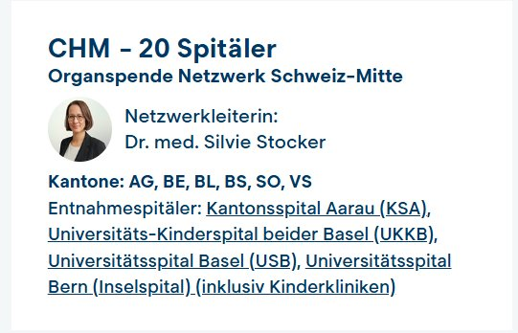
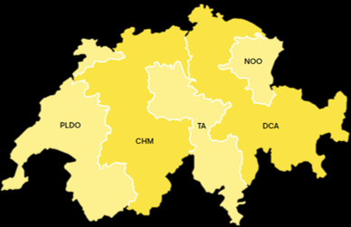
5 donation networks
Organization
Swisstransplant mandated by the CDS for:
Regional grouping of hospitals
Training of medical staff
Implementation of legal directives
Implementation of standard processes
Use of synergies at national level

Slide 7
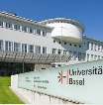
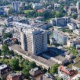
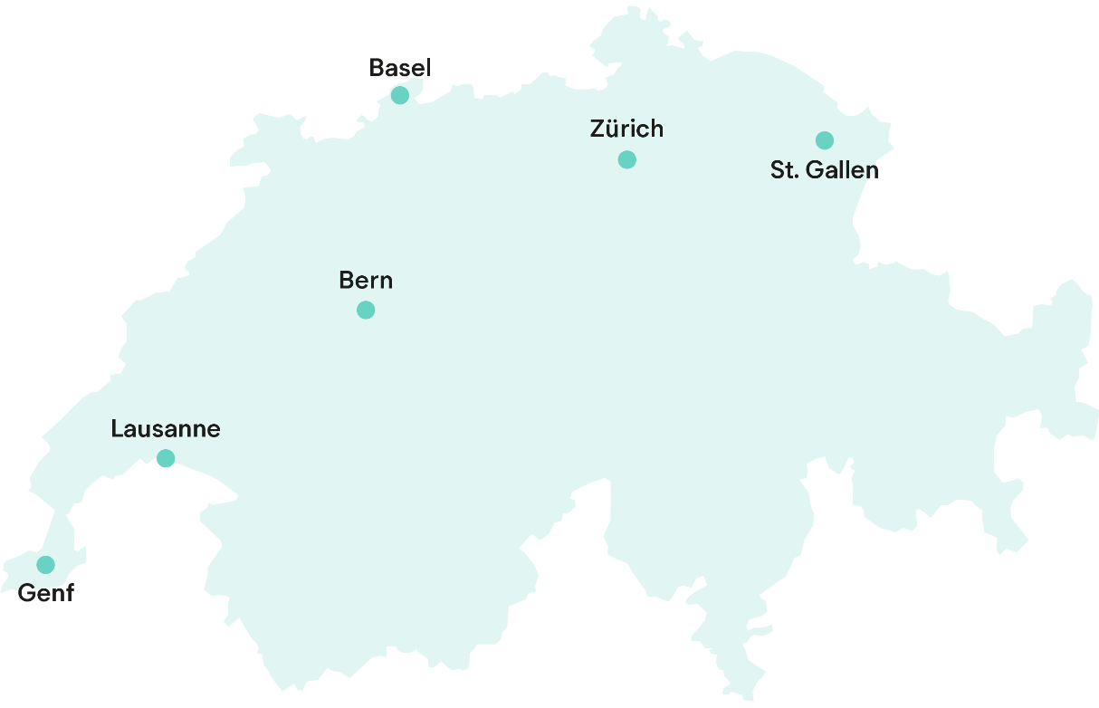
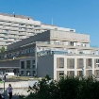
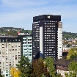
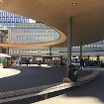
Transplant centres in Switzerland
Organization
University Hospital of Bern (Inselspital)
University Hospital of Basel (USB)
University Hospital of Zurich (USZ)
University Hospital of Vaud (CHUV)
Cantonal Hospital of St. Gallen (KSSG)
University Hospital of Geneva (HUG)

Slide 8
Transplantation Act
02
Swisstransplant
Politics and society

Slide 9
Transplantation Act
Politics and society
Federal Act on the Transplantation of Organs, Tissues and Cells (Transplantation Act), 2007
Replaced cantonal legislation regulating donor and recipient aspects
Creation of a national allocation service
Essential points of the law
Principle of free access and prohibition of trade
Principle of explicit consent in the broader sense*
Organ allocation according to by-laws
* In May 2022, the Swiss electorate approved the introduction of the extended opt-out system. The Organ and Tissue Donation Register is set to be introduced in the first quarter of 2027. The opt-out system is then scheduled to take effect no earlier than the third quarter of 2027 (bag.admin.ch).

Slide 10
Politics and society
What is the extended opt-out solution?
If a person objects to organ donation while they are alive, they are no longer an organ donor. ​
If the deceased person made no statement regarding organ donation prior to their death, the next of kin are consulted. “Do you know if the deceased stated or would state that they do not want to be an organ donor?”
If there is no objection or any other statement regarding the willingness of the deceased to be a donor, and if no next of kin can be found despite efforts being made, no organs may be removed.

Slide 11
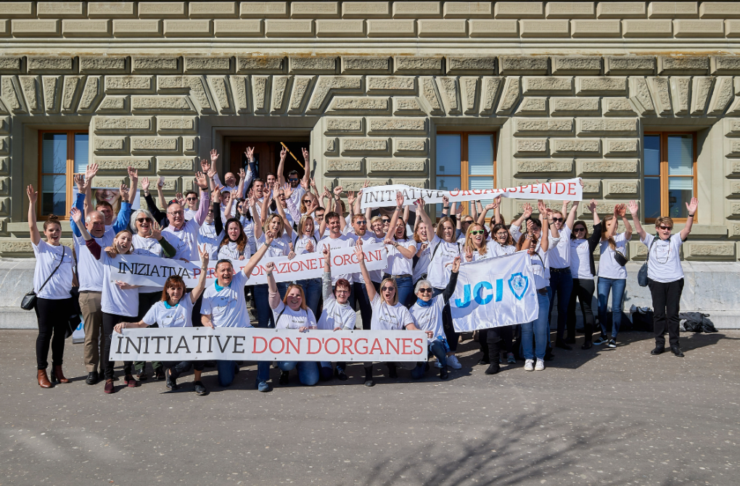
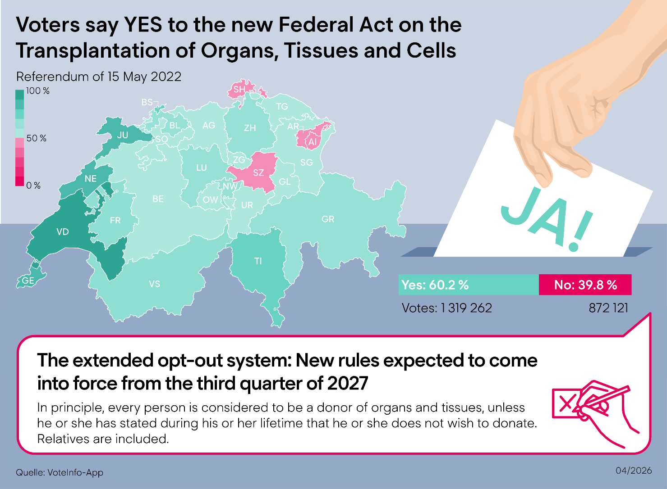
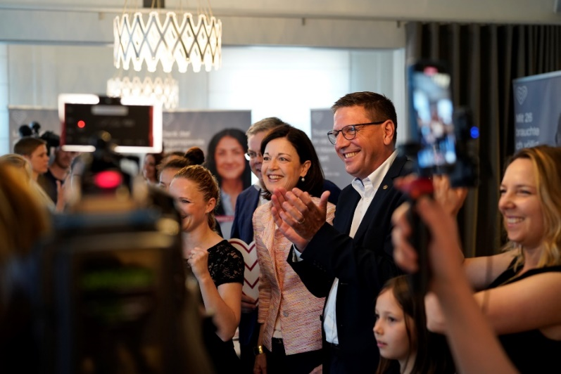
Change of system: Extended opt-out solution
Politics and society
60.2 % yes

Slide 12
Facts and figures
03
Swisstransplant
Organ donation in Switzerland

Slide 13
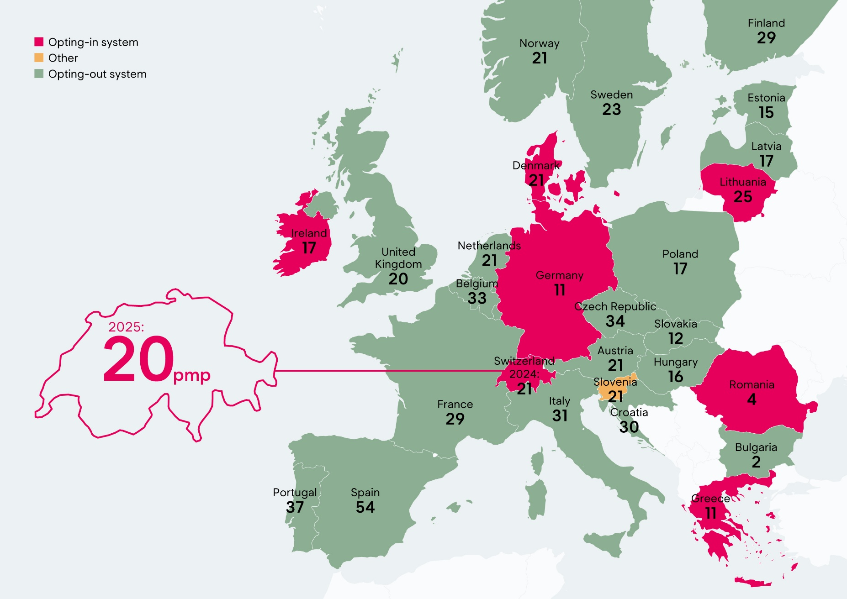
Donation rate in Europe
Regulations international

Slide 14
Swisstransplant annual figures − deceased donors
Facts and figures
Swisstransplant

Slide 15

Post-mortem donation
Facts and figures
DBD: donation after brain death
Brain-dead donor
Circulation mechanically stabilized
Donation of all organs possible
DCD: donation after cardiocirculatory death
Non-heart-beating donor
Change of therapy – not brain-dead
Donation of all organs possible

Slide 16
Transplantation through living donation
Facts and figures
Living organ donation in Switzerland
A kidney or part of the liver
Directed donation
Altruistic donation
Kidney paired donation

Slide 17
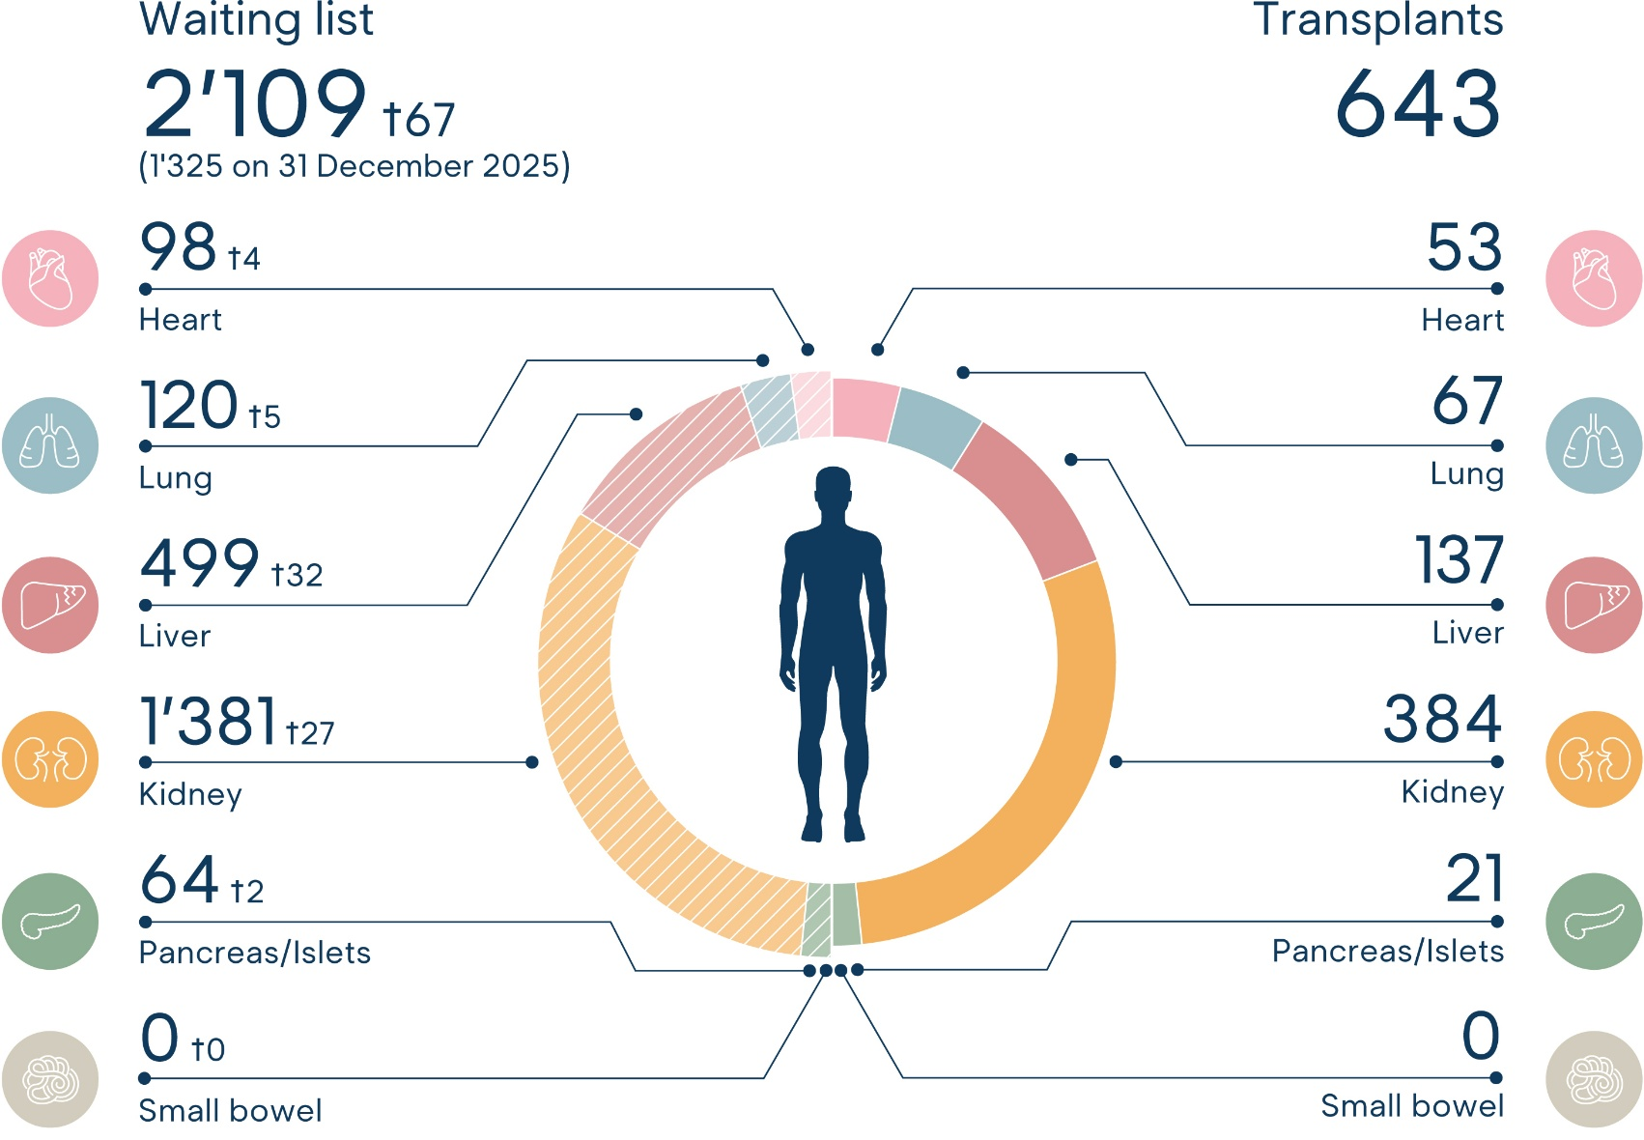
Waiting list and transplantations (1 Jan.−31 Dec. 2024)
Facts and figures
Annual report Swisstransplant 2025

Slide 18


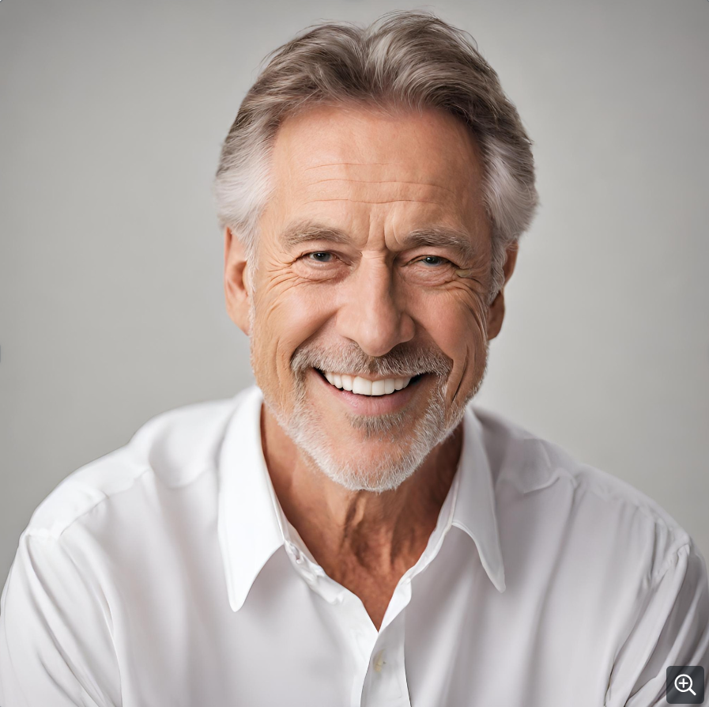
Typical example
Facts and figures
60 years old

Slide 19
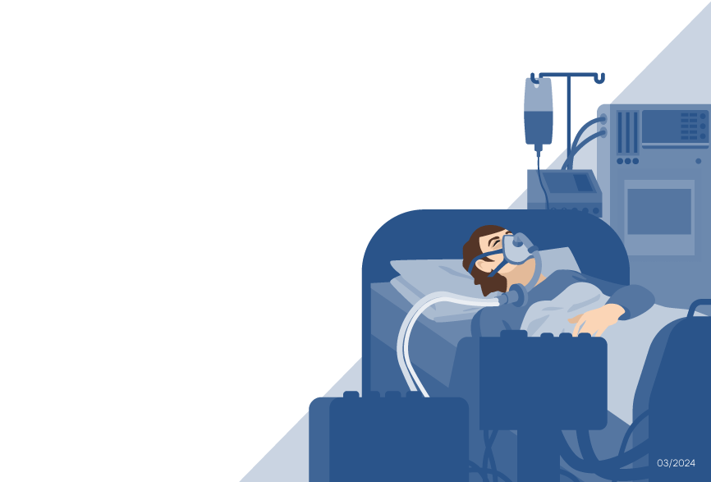
Causes and frequency of death in organ donors – Distribution in %
Facts and figures
n total = 185 donors
03/2026

Slide 20
Causes and frequency of death in organ donors – Distribution in %
Facts and figures
DBD
DCD
n total = 95 donors
rounded values
n total = 90 donors

Slide 21
Absolute medical contraindications
Facts and figures
Untreatable sepsis
Degenerative disorder CNS*
Rabies virus, prion disease (e.g. Creutzfeldt-Jakob disease CJD)
*CNS = central nervous system

Slide 22

Brain death
Post-mortem donation
Irreversible failure of the brain and brain stem
The organs receive the oxygen they need to continue functioning through mechanical ventilation.
Brain death: not to be confused with coma
Coma: potentially reversible partial lesions of the brain. Patients react to certain stimuli; measurable brain activity.

Slide 23
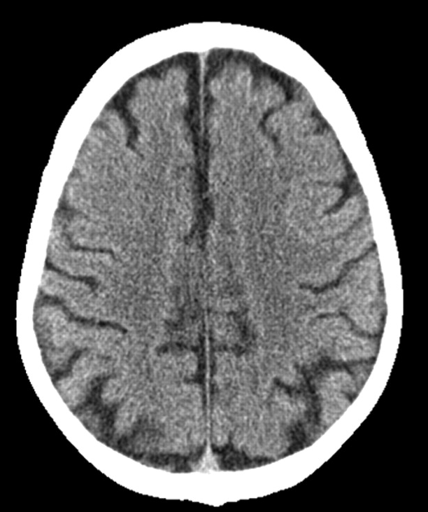
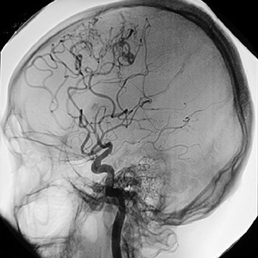
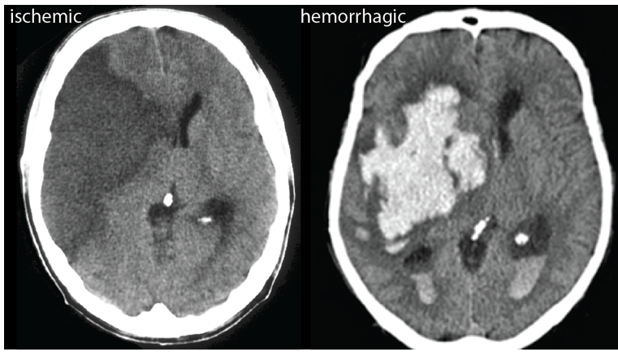
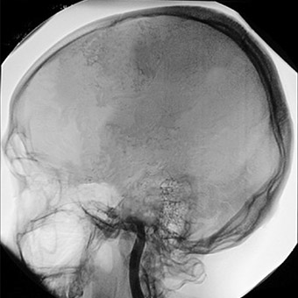
Brain death – diagnosis through imagery
Post-mortem donation
Normal circulation
Interrupted circulation
MRI/angiogram of a brain with normal circulation
CT scan/angiogram of brain with interrupted circulation
M. van Straten (2007); American Journal of Neuroradiology 28 (3) 421-427, https://donatelifecalifornia.org/ und Kummer (2019); https://ysjournal.com/

Slide 24
Brain death − natural process vs. process in intensive care unit
Post-mortem donation
Natural process:
Process in intensive care unit:
Increased intracranial pressure
Interruption of blood flow
Total loss of brain function
Respiratory arrest
Severe brain damage
Cardiac arrest
Increased intracranial pressure
Interruption of blood flow
Total loss of brain function
Mechanical respiration/stabilisation of circulation
Severe brain damage
Maintenance of blood perfusion to the organs

Slide 25



Who can be a donor?
Post-mortem donation
Mechanically ventilated and stabilized circulation
Brain death of known cause
No medical contra-
indications
Consent to organ donation

Slide 26
Process of organ donation
04
Swisstransplant
Procedure

Slide 27
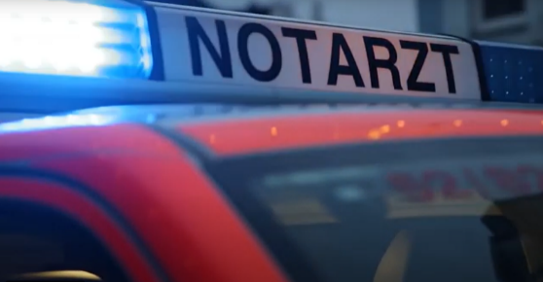
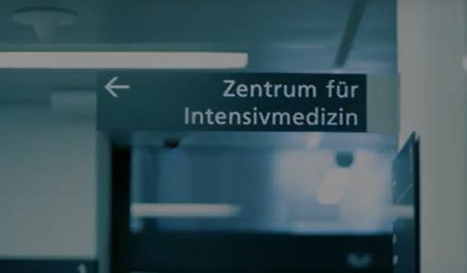


Procedure
Process of organ donation
1. Hospitalization
2. Intensive care
Mechanically ventilated
Medication maintains circulatory function
If the brain and brain stem functions are irreversibly affected, there is no possible further treatment
Saving the patient is always the priority. Organ donation is only discussed when this is not possible.

Slide 28
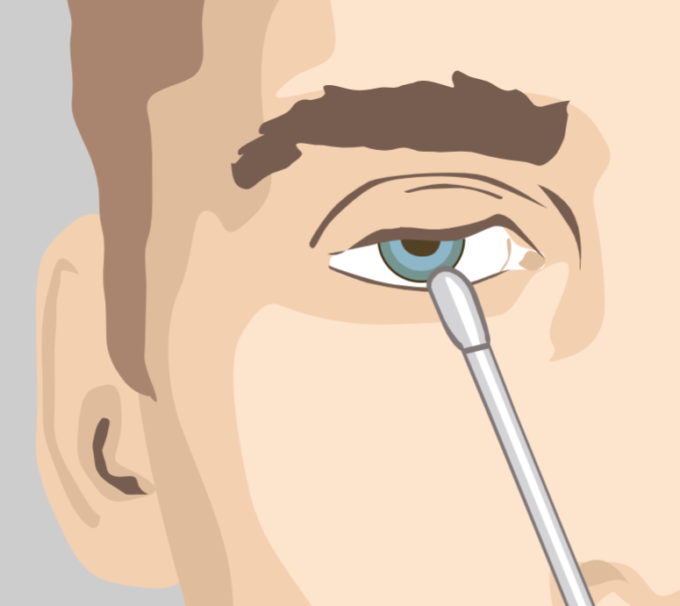
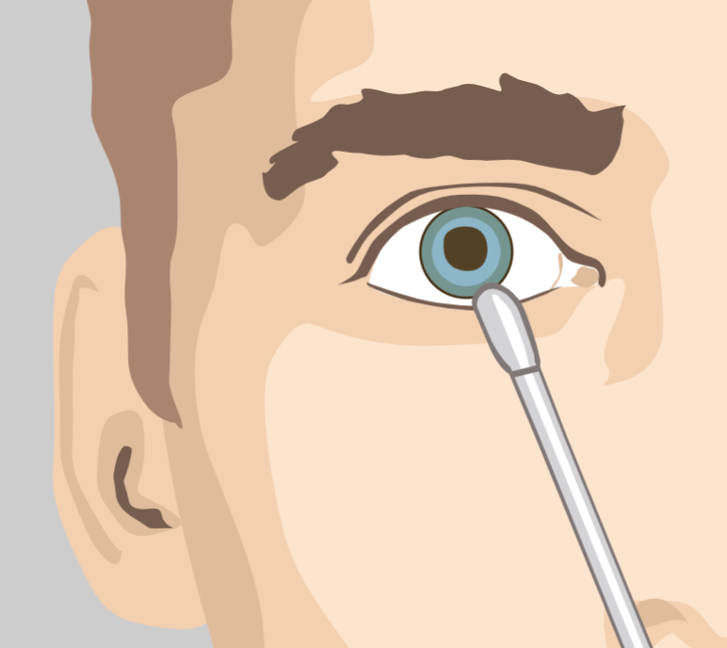
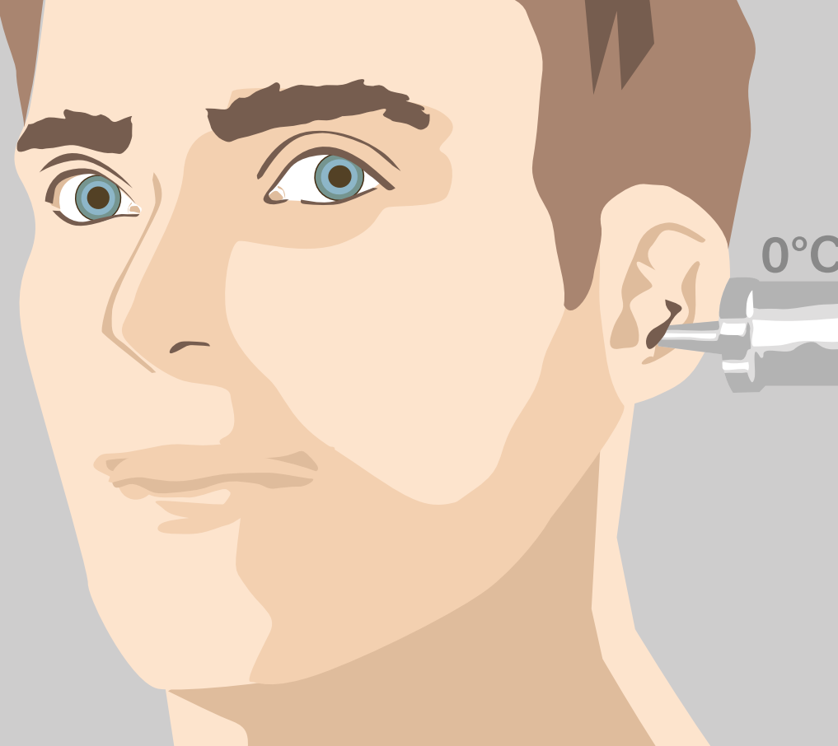
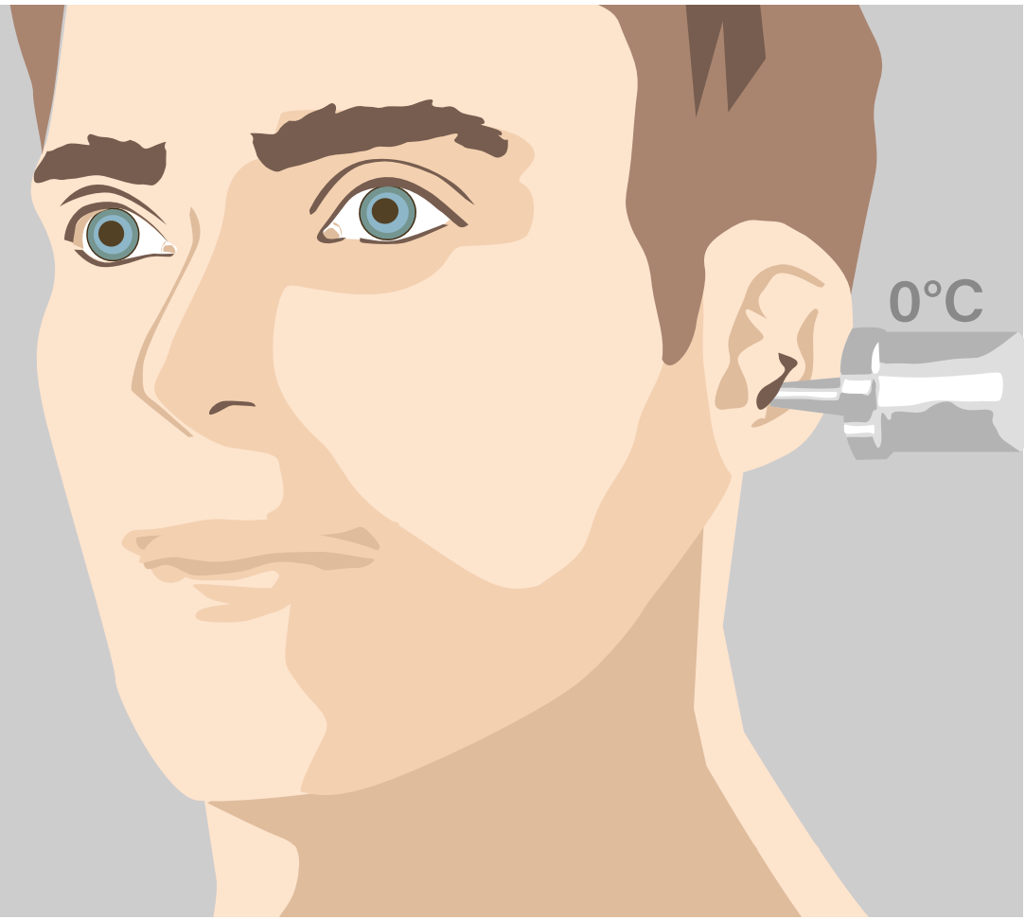
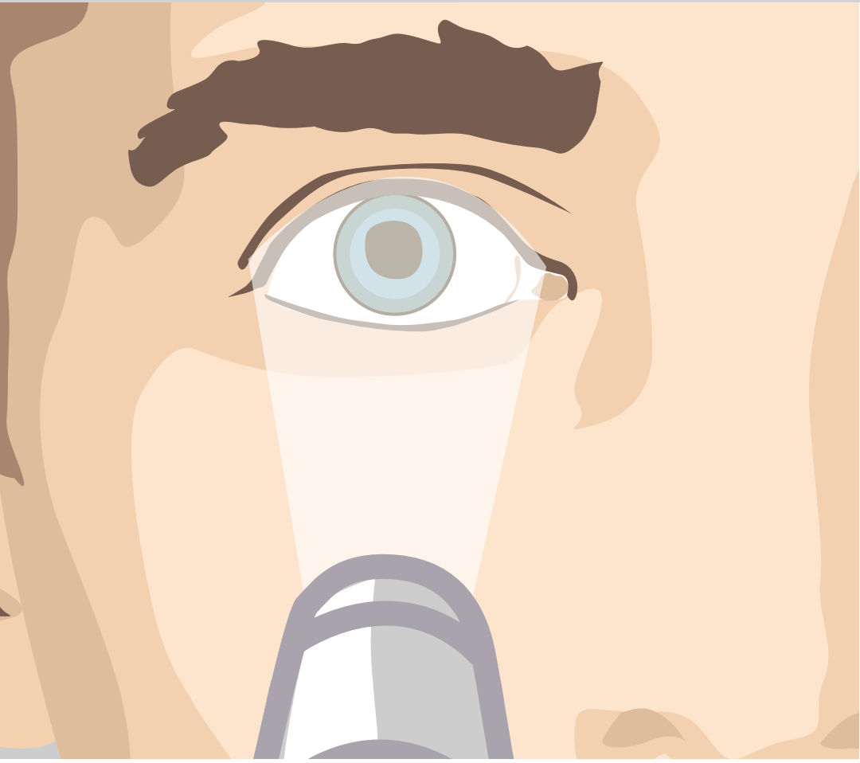
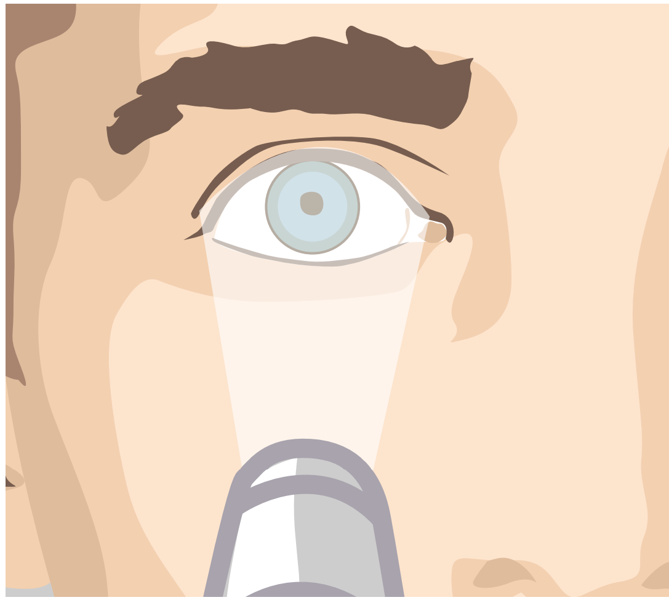

Procedure
Process of organ donation
3. Diagnosis of brain death
Carried out by two impartial specialists who are not involved in the transplant procedure
7 clinical signs: brainstem reflex test
Examples of normal and pathological reactions
Corneal reflex
Vestibulo-ocular reflex
Mydriatic test

Slide 29
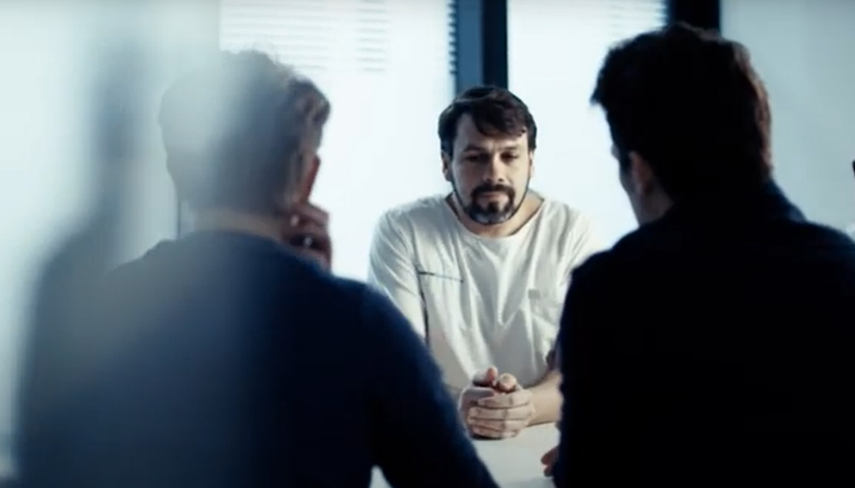

Procedure
Process of organ donation
4. Consent
First approach: informed of brain death/life-threatening condition
Second approach: question of wishes of the deceased regarding organ donation
No urgency for the decision

Slide 30
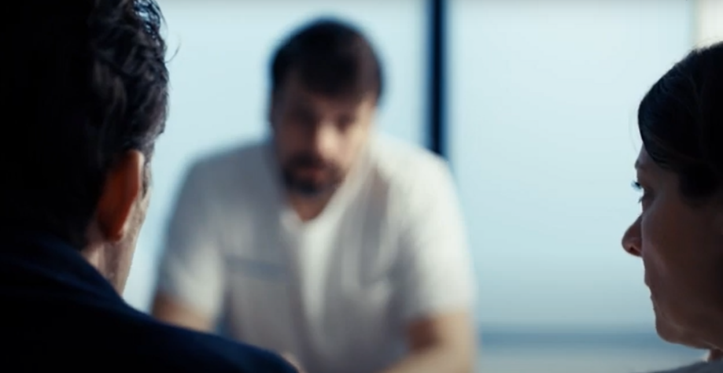
Procedure
Process of organ donation
5. Discussion with relatives
Away from the patient’s bed
Announcement of death or hopeless diagnosis and change of treatment
Organ and tissue donation discussed
6. Time frame
Maximum of 48 hours between the change of treatment and brain death (otherwise DCD donation)
Organ procurement must be completed within 72 hours of the diagnosis of brain death

Slide 31


Procedure
Process of organ donation
7. Swisstransplant
Permission given
Brain death/change of treatment
Data entry of the deceased:
Case history
Results
Laboratory tests
Imagery

Slide 32
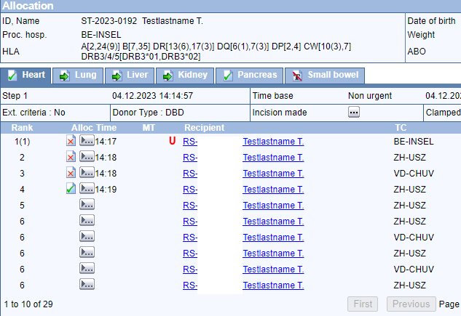
Procedure
Process of organ donation
8. Waiting list/ranking
Data entry in the SOAS (Swiss Organ Allocation System)
Swisstransplant – calculation of the ranking of the potential recipients using SOAS software
The ranking list depends on donor characteristics
fictitious example SOAS

Slide 33

Procedure
Process of organ donation
9. Attribution
The ranking list is calculated on the basis of the distribution rules of the law using an algorithm
Swisstransplant offers organs to centres for potential recipients
1
2
3
4
Medical urgency
Medical
benefit
Priority
(children/blood
Group)
Waiting
time

Slide 34
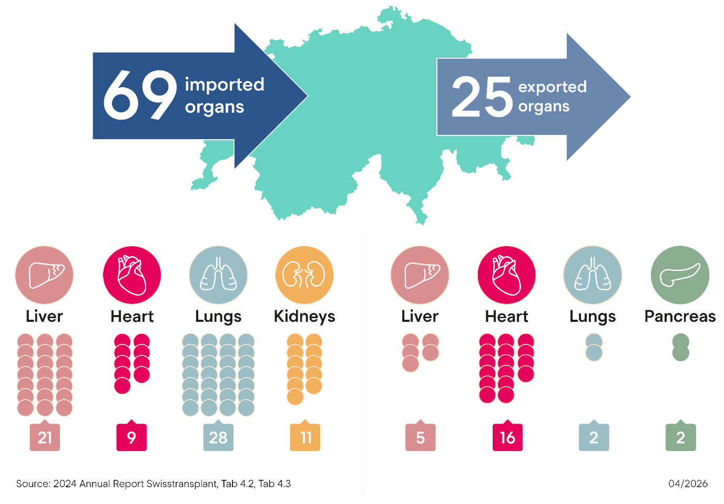

Process of organ donation
Procedure
9. Attribution
Cooperation with European allocation centres
Bern
Lausanne
Zurich
St. Gallen
Basel
Geneva
Agence de la biomédecine

Slide 35

Procedure
Process of organ donation
10. Planning
Timing: everything at the right time and place
Limiting factors:
Availability of operating rooms
Anaesthesia team, procurement team
Hospital routine
Flight time, workload, weather

Slide 36
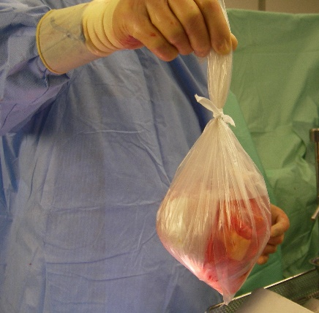
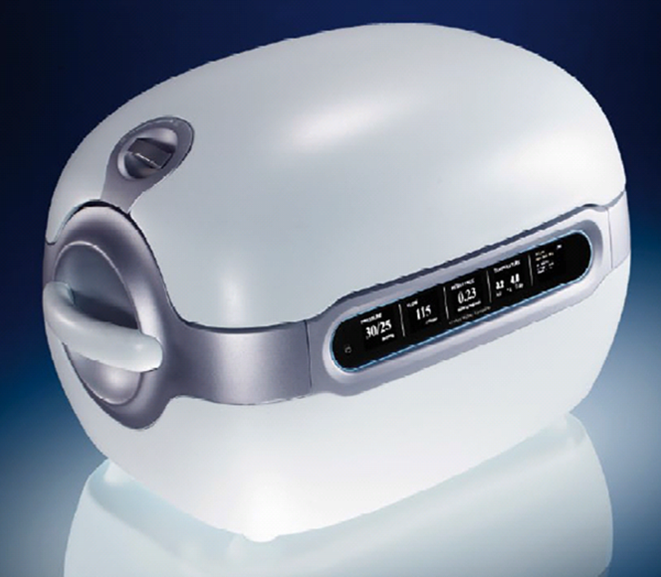

Procedure
Process of organ donation
11. Procurement
Organs procured by surgeons from donor hospital
Correct conditioning of organs
Accompanied or unaccompanied transport of organs to recipient hospital

Slide 37

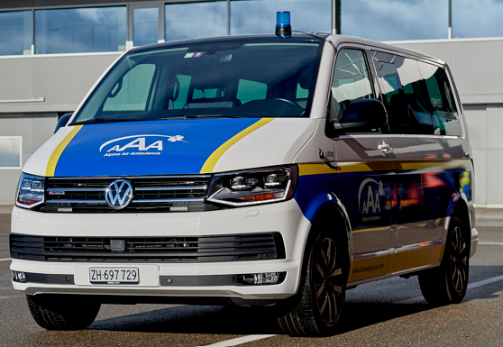

Procedure
Process of organ donation
12. Transport
Taxi, ambulance, helicopter, jet
Ischemia time: the time interval between the interruption of the organ’s blood supply in the donor’s body and the resumption of the organ’s blood flow in the recipient’s body
Heart
Lungs/liver/pancreas
Kidneys
3−4 h
6−8 h
12−24 h

Slide 38

Procedure
Process of organ donation
13. Transplantation
Preliminary examinations carried out on the recipient
Transplantation carried out in transplant centre
After a successful operation, the transplanted organ regains its function.

Slide 39
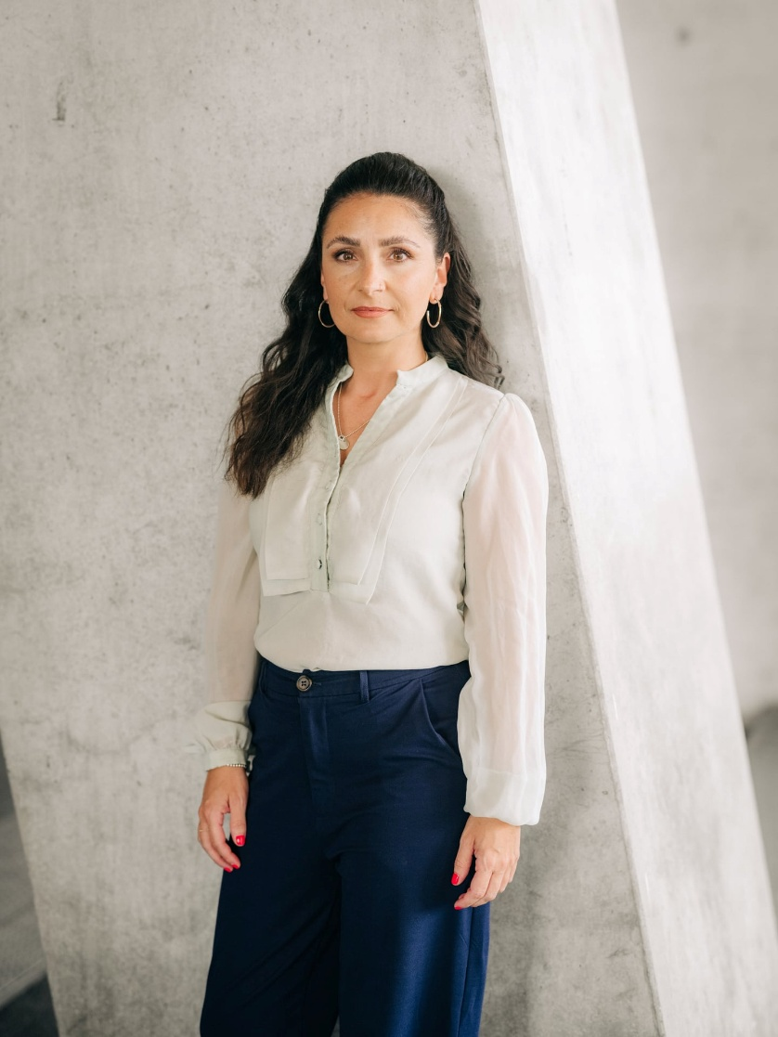
Organ recipients
After organ donation
Improved quality of life
Lifetime medication (immunosuppression)
Prolongation of life
Possibility to write an anonymous thank you letter to the donor family
Laura, lung recipient

Slide 40
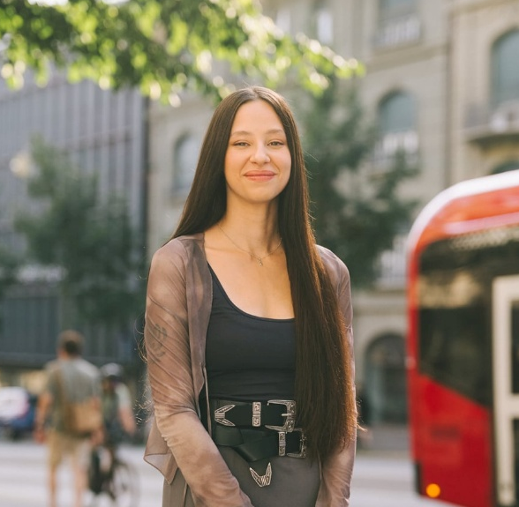
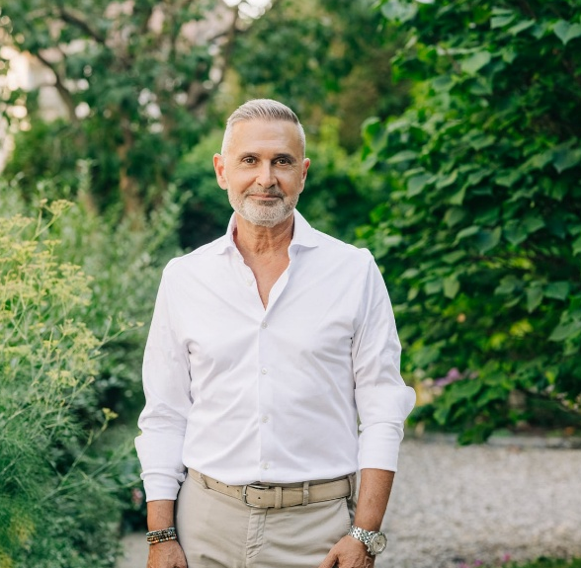
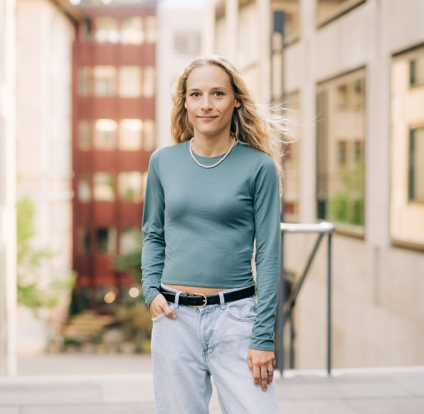
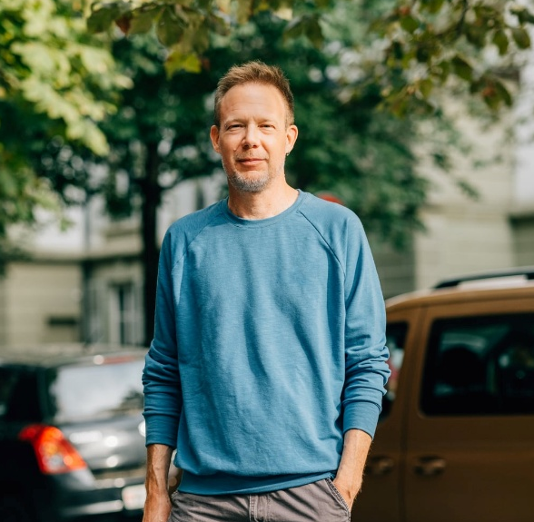

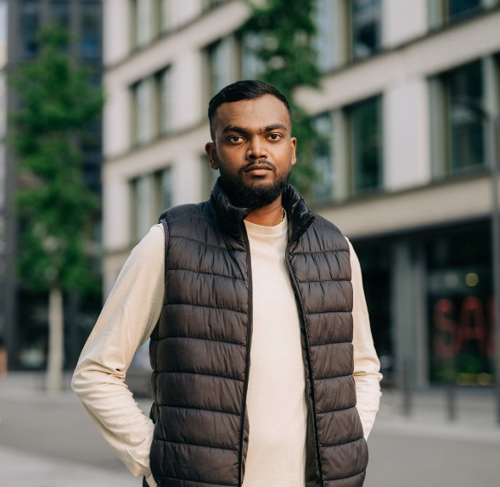
Organ recipients
Ambassadors
Anaïs, kidney recipient
Giuseppe, liver recipient
Lisa, liver recipient
Nicolas, lung recipient
Renata, heart recipient
Elilan, kidney recipient

Slide 41
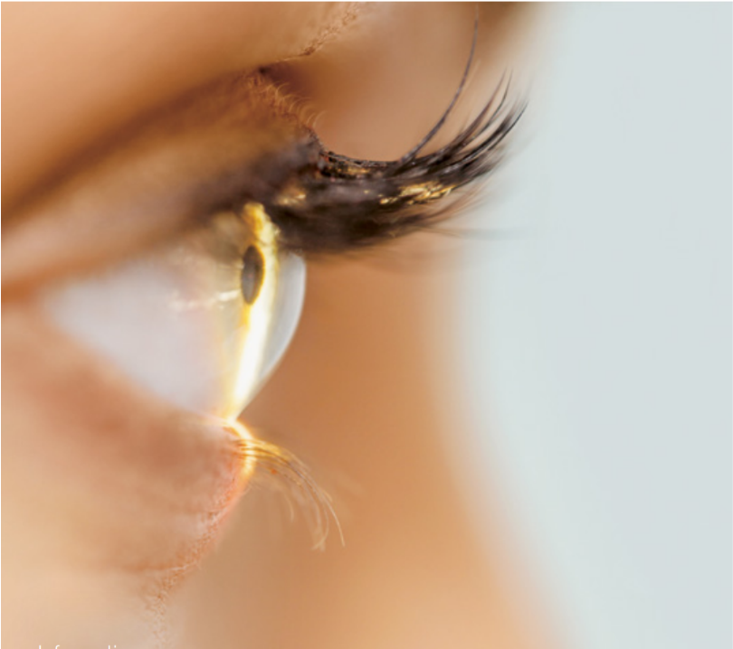

Tissue donation
After organ donation
In case of death in hospital
24−48 hours after death
Consent
Categories on donor card
Cornea
Cardiac valves, large blood vessels
Vessels
Corneal transplantation after eye injury, corneal infections (keratitis)

Slide 42


Saying goodbye
Process of organ donation
Possibility for relatives to say goodbye to the deceased
Funeral organized according to the wishes of the deceased and his or her relatives
Last respects, cremation or burial possible
Support for relatives provided by local coordinators
Most important principle: dignified treatment both before and after the organ removal.

Slide 43
Questions
05
Swisstransplant
Thanks and conclusion

Slide 44
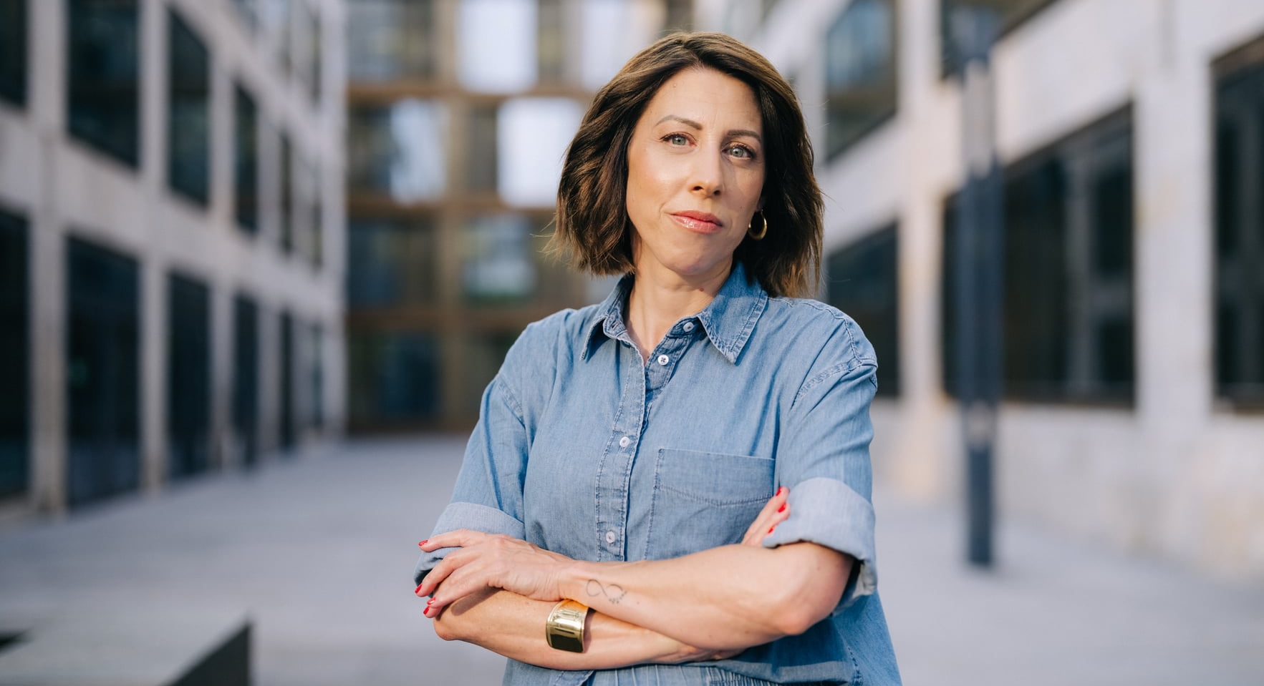
Thank you!
Swisstransplant Effingerstrasse 1 P.O. Box CH-3011 Bern T +41 58 123 80 00
www.swisstransplant.org info@swisstransplant.org
© Swisstransplant
Ana, lung recipient
Sandra, kidney recipient

Slide 45
Video suggestions for your presentation:
Swisstransplant Vision and Mission
Explanatory video: How does organ donation work in Switzerland?
When is a person dead?
Digitization process organ donation and transplantation
Noah's organ donation – grief and hope
A completely normal life
Elio – Back to Life

