Slide 1
Organ donation and transplantation
Swiss National Foundation for Organ Donation and Transplantation
Aline, heart recipient
Bern | 2023
info@swisstransplant.org

Slide 2
Objectives of the presentation
Home
The Swisstransplant Foundation
Transplantation Act
Facts and figures
Organ donation procedure
Questions

Slide 3
Swisstransplant
01
Swisstransplant
Structure and organization

Slide 4
Swisstransplant – Swiss National Foundation for Organ Donation and Transplantation
Swisstransplant Foundation
1985 Creation of the Foundation in Geneva
Bern
2007 Mandated by the Federal Office of Public Health (FOPH) as the national allocation service
Allocation of organs to recipients in accordance with the law
Management of the waiting list
2009 Allocation of benefits by the Swiss Conference of the Cantonal Ministers of Public Health
Coordination and development of organ donation at the national level
Compensation in the organ donation process/financing of hospital staff (H+/SVK)

Slide 5
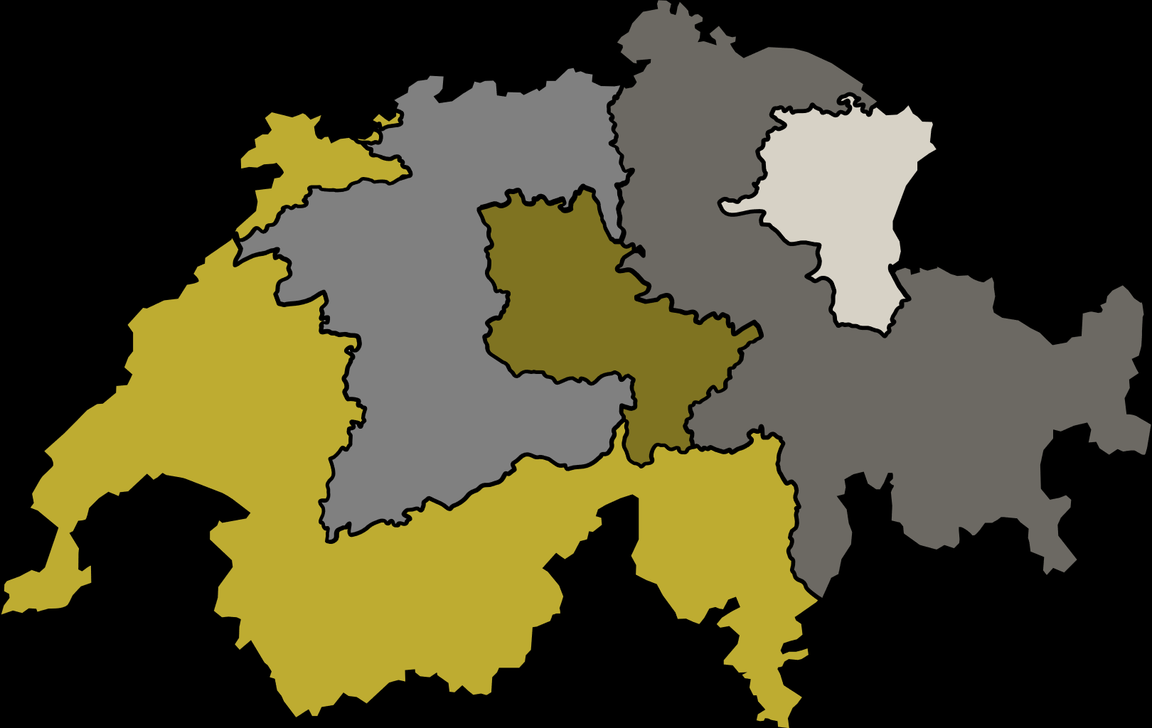
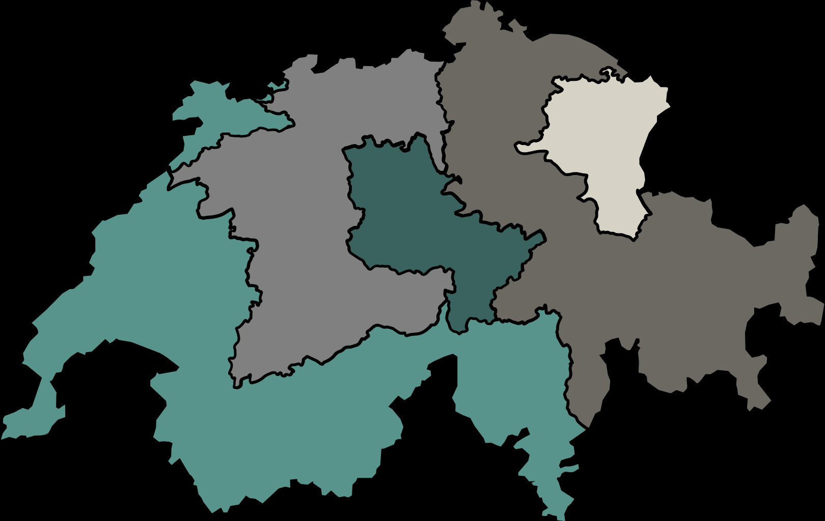
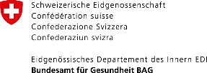
Collaboration
Partners
Organ donation
Organ donation networks
CHM
NOO
LU
Swiss Hospital (group)
DCA
PLDO
Transplantation
Transplant centres
Basel
Zurich
St. Gallen
International collaboration
Bern
FOEDUS – European Organ Exchange Organisation
CD-P-TO – European Committee on Organ, Tissue and Cell Transplantation
Lausanne
Geneva

Slide 6
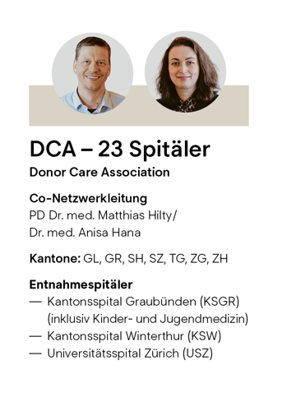
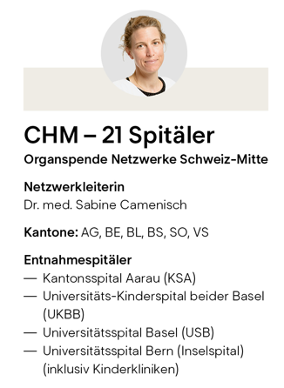
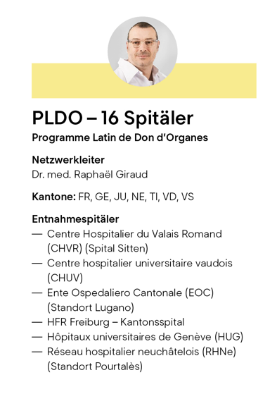
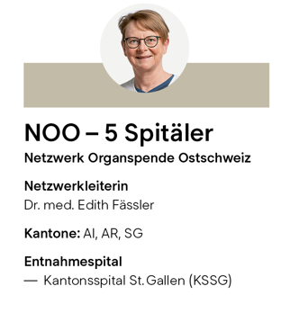
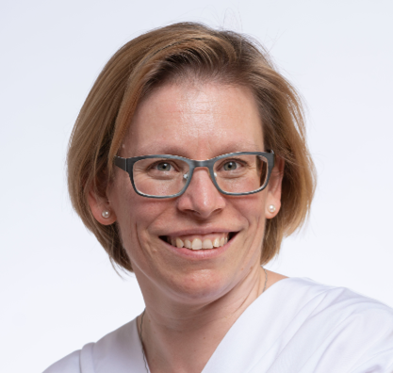
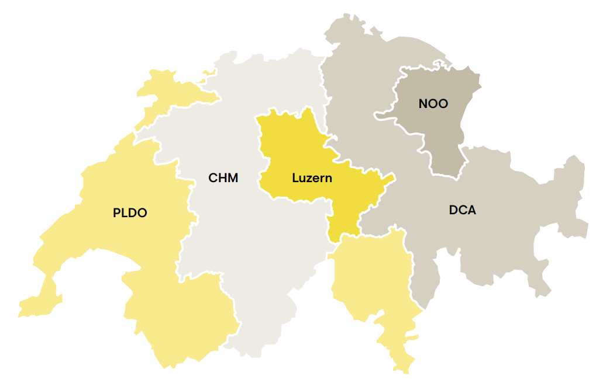
Donation networks
Organization
Dr. med. Yvonne Hilpertshauser
Dr. med. Yvonne Hilpertshauser
Swisstransplant mandated by the CDS for:
Regional grouping of hospitals
Training of medical staff
Implementation of legal directives
Implementation of standard processes
Use of synergies at national level
Notes:
Sollen hier die Leiter Bleiben oder eher Aufgaben???

Slide 7
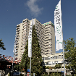
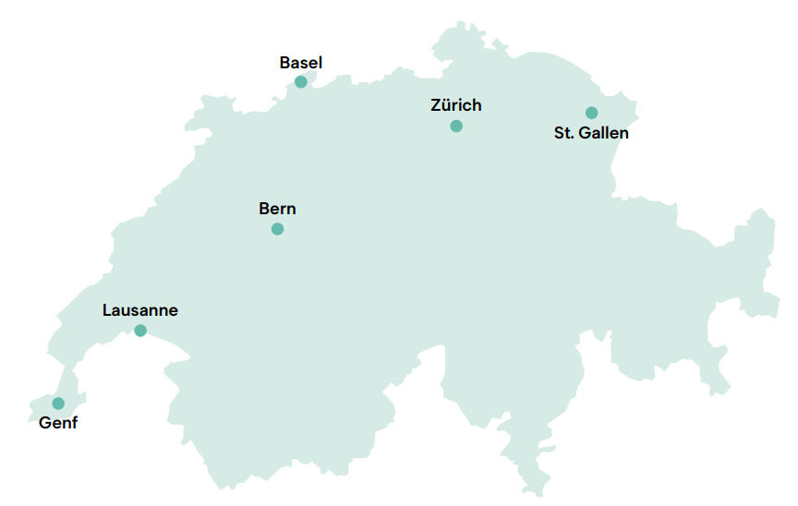
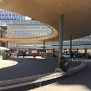
Transplant centres in Switzerland
Organization
University Hospital of Bern (Inselspital)
University Hospital of Basel (USB)
University Hospital of Zurich (USZ)
University Hospital of Vaud (CHUV)
Cantonal Hospital of St. Gallen (KSSG)
University Hospital of Geneva (HUG)

Slide 8
Transplantation Act
02
Swisstransplant
Politics and society

Slide 9
Transplantation Act
Politics and society
Federal Act on the Transplantation of Organs, Tissues and Cells (Transplantation Act), 2007
Replaced cantonal legislation regulating donor and recipient aspects
Creation of a national allocation service
Essential points of the law
Principle of free access and prohibition of trade
Principle of explicit consent in the broader sense*
Organ allocation according to by-laws
* On 15 May 2022, the people approved the principle of presumed consent in the broad sense. The new regulation will come into force in 2025 at the earliest (bag.admin.ch).

Slide 10
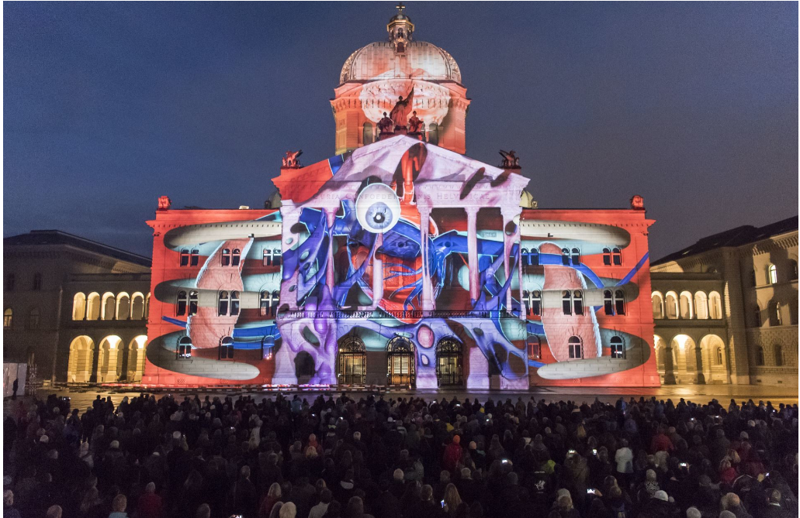
Change of system: Extended opt-out solution
Politics and society
Political initiatives in Parliament
2010: Unsuccessful
2015: Majority in the National Council (66%), defeated
in the Council of States by one vote

Slide 11
What is the extended opt-out solution?
Politics and society
If a person objects to organ donation while they are alive, they are no longer an organ donor. ​
If the deceased person made no statement regarding organ donation prior to their death, the next of kin are consulted. “Do you know if the deceased stated or would state that they do not want to be an organ donor?”
If there is no objection or any other statement regarding the willingness of the deceased to be a donor, and if no next of kin can be found despite efforts being made, no organs may be removed.

Slide 12
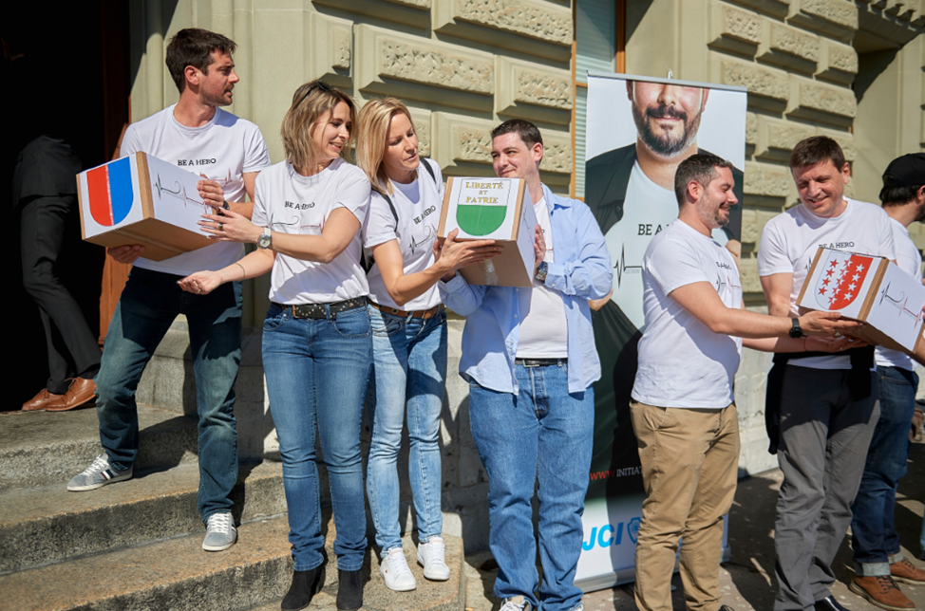
Change of system: Extended opt-out solution
Politics and society
Federal popular initiative “Pour sauver des vies en favorisant le don d’organes”
17.10.2017 to 22.03.2019: 113,000 certified signatures
13.09.2019: Indirect counterproposal by FDHA
05.05.2021: >80% “Yes” in the National Council
20.09.2021: >60% “Yes” in the Council of States
20.01.2022: Referendum with 50,000 signatures
Source: Alexandra Jäggi
Popular vote 15 May 2022

Slide 13
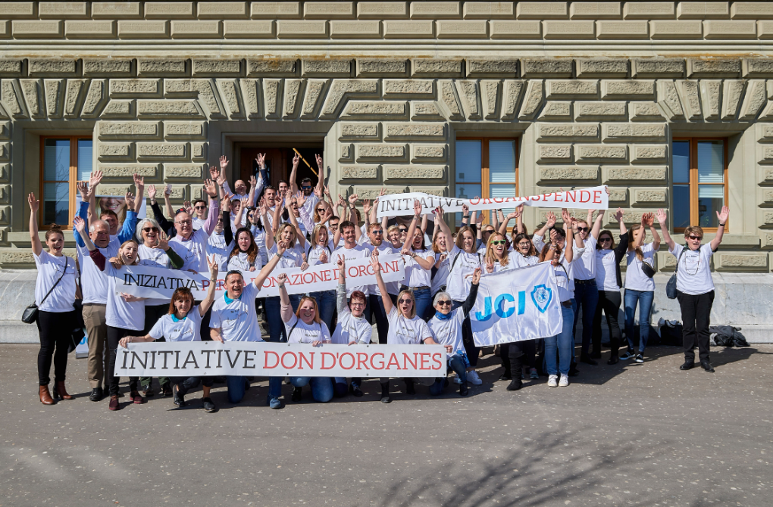
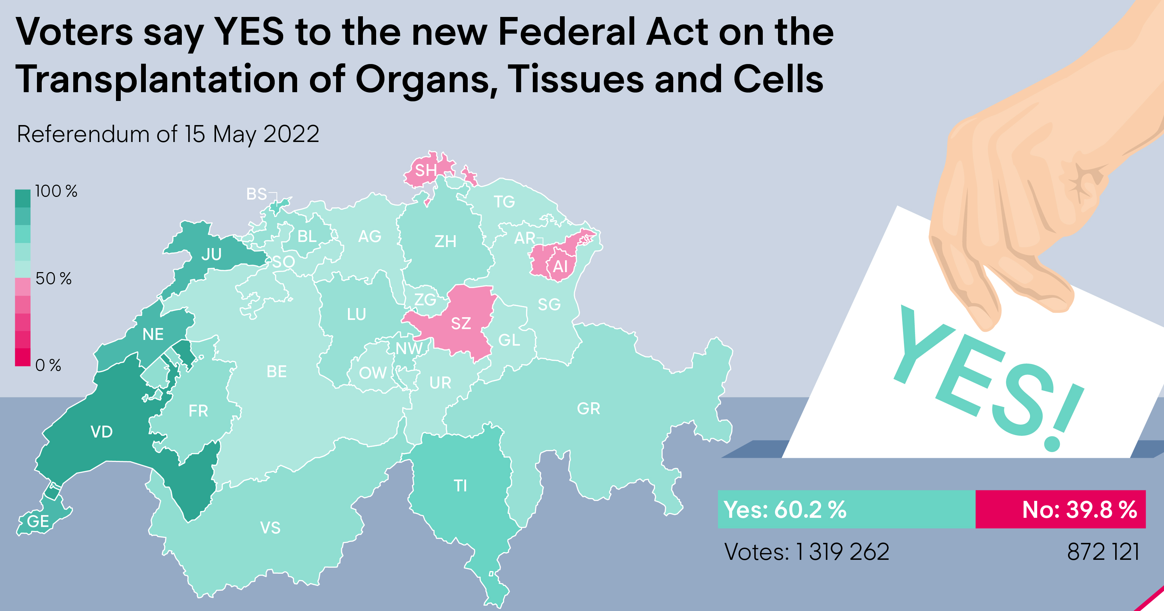
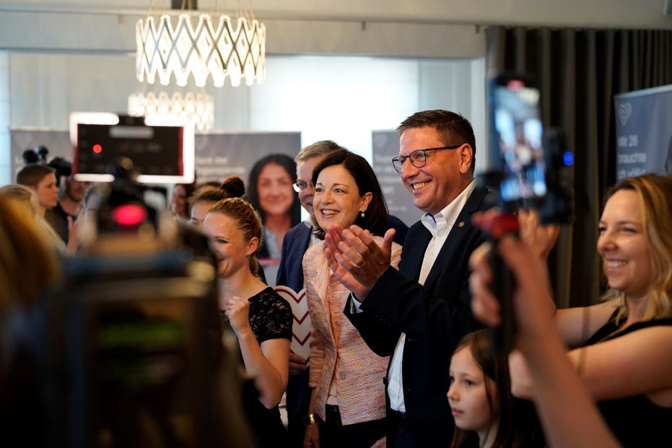
Change of system: Extended opt-out solution
Politics and society
Source: Alexandra Jäggi

Slide 14
Effective numbers of deceased donors
Politics and society

Slide 15
Politics and society

Slide 16
Facts and figures
03
Swisstransplant
Organ donation in Switzerland

Slide 17
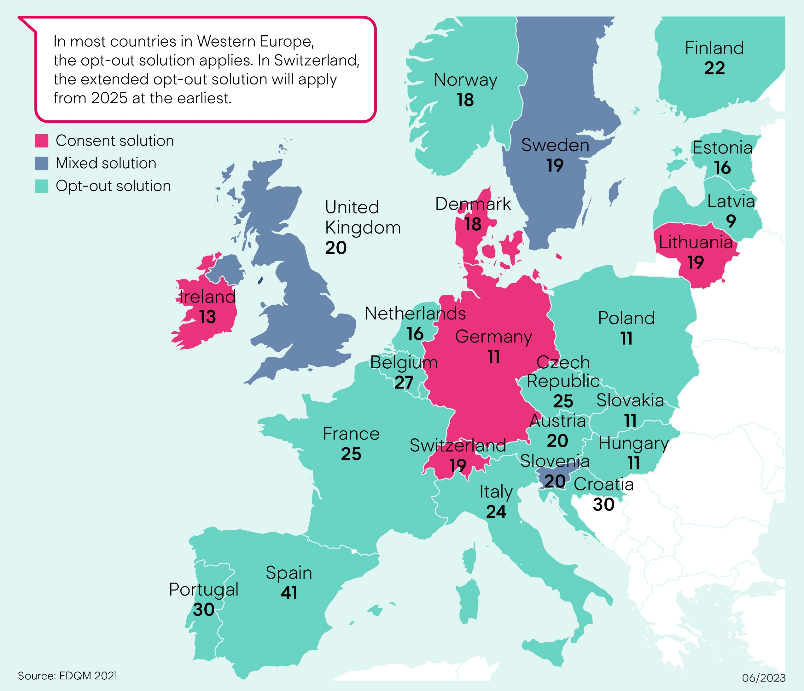
Donation rate in Europe
Regulations international

Slide 18
Swisstransplant annual figures − deceased donors
Facts and figures

Slide 19
Post-mortem donation
Facts and figures
DBD: donation after brain death
Brain-dead donor
Circulation mechanically stabilized
Donation of all organs possible
DCD: donation after cardiocirculatory death
Non-heart-beating donor
Change of therapy – not brain-dead
Donation of all organs possible

Slide 20
Transplantation through living donation
Facts and figures
Living organ donation in Switzerland
A kidney or part of the liver
Directed donation
Altruistic donation
Crossed donation

Slide 21
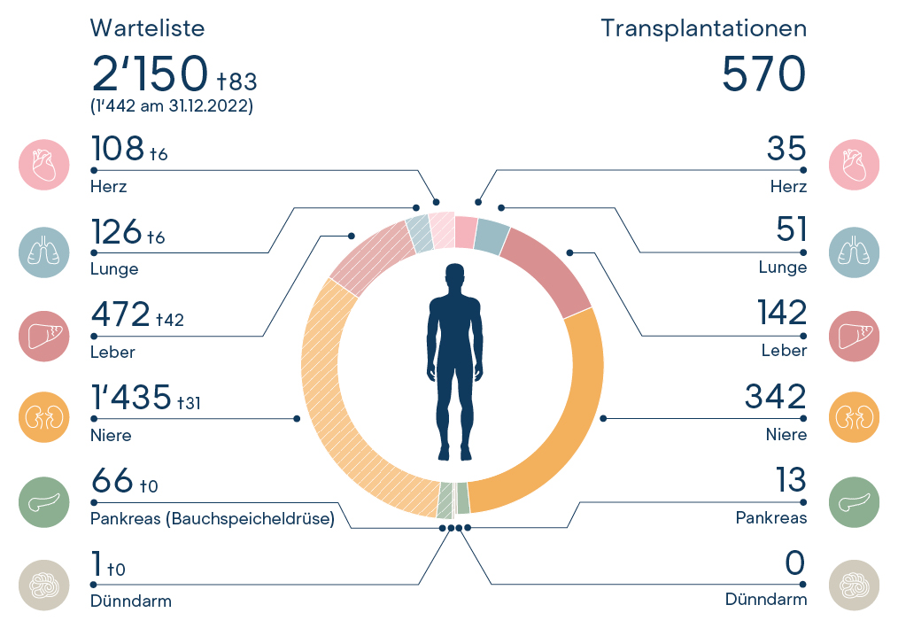
Waiting list and transplantations (1 Jan.−31 Dec. 2022)
Facts and figures

Slide 22
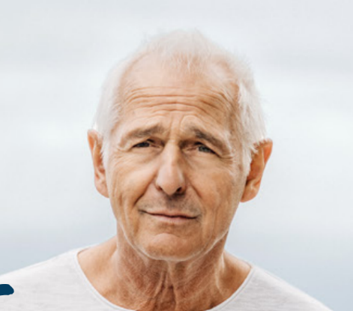
Typical example
Facts and figures
60 years old

Slide 23
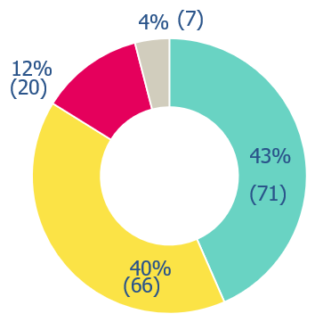
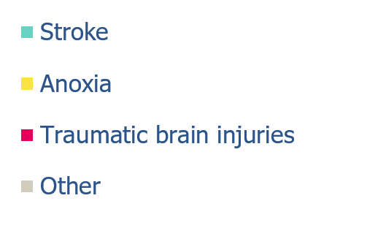
Causes and frequency of death in organ donors
Facts and figures
Distribution in %
n total = 164 donors

Slide 24
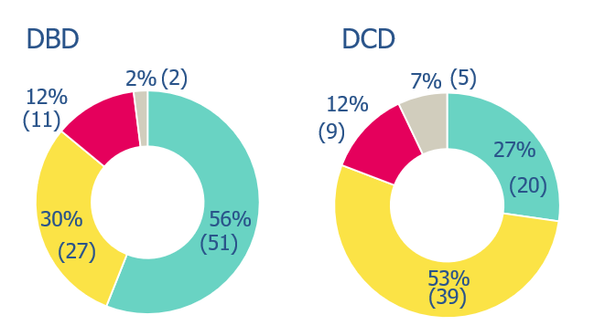
Causes and frequency of death in organ donors
Facts and figures
n = 91 donors
n = 73 donors
% annual figures

Slide 25
Absolute medical contraindications
Facts and figures
Untreatable sepsis
Degenerative disorder of the central nervous system (CNS)
Rabies virus, prion disease (e.g. Creutzfeldt-Jakob disease CJD)

Slide 26
Brain death
Post-mortem donation
Irreversible failure of the brain and brain stem
The organs receive the oxygen they need to continue functioning through mechanical ventilation.
Brain death: not to be confused with coma
Coma: potentially reversible partial lesions of the brain. Patients react to certain stimuli; measurable brain activity.

Slide 27
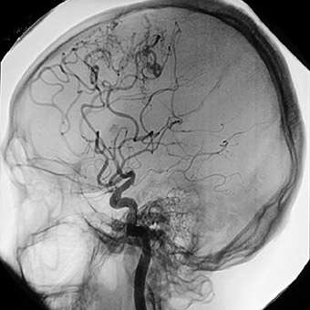
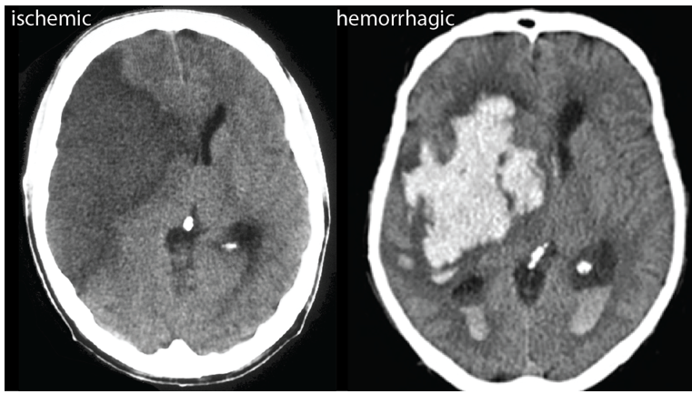
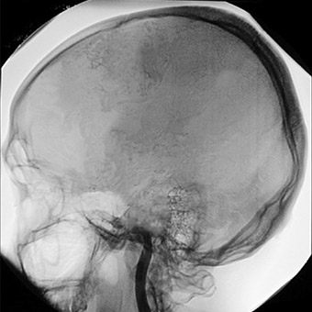
Brain death – diagnosis through imagery
Post-mortem donation
Normal circulation
Interrupted circulation
MRI/angiogram of a brain with normal circulation
CT scan/angiogram of brain with interrupted circulation
M. van Straten (2007); American Journal of Neuroradiology 28 (3) 421–427, https://donatelifecalifornia.org/ et Kummer (2019); https://ysjournal.com/

Slide 28
Brain death − natural process vs. process in intensive care unit
Post-mortem donation
Increased intracranial pressure
Interruption of blood flow
Total loss of brain function
Respiratory arrest
Severe brain damage
Cardiac arrest
Increased intracranial pressure
Interruption of blood flow
Total loss of brain function
Mechanical respiration/stabilisation of circulation
Severe brain damage
Maintenance of blood perfusion to the organs

Slide 29
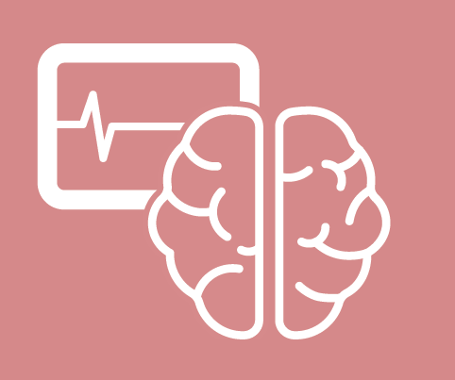
Who can be a donor?
Post-mortem donation
Mechanically ventilated and stabilized circulation
Brain death of known cause
No medical contra-
indications
Consent to organ donation

Slide 30
Process of organ donation
04
Swisstransplant
Procedure

Slide 31
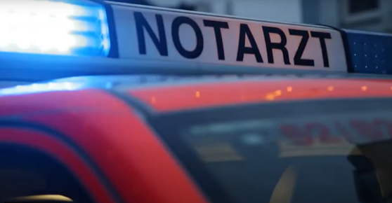
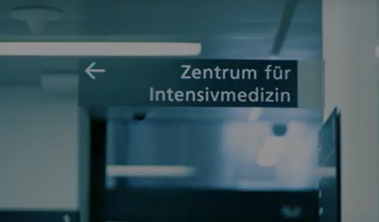
Procedure
Process of organ donation
Hospitalization
Intensive care
Mechanically ventilated
Medication maintains circulatory function
If the brain and brain stem functions are irreversibly affected, there is no possible further treatment
Saving the patient is always the priority. Organ donation is only
discussed when this is not possible.

Slide 32
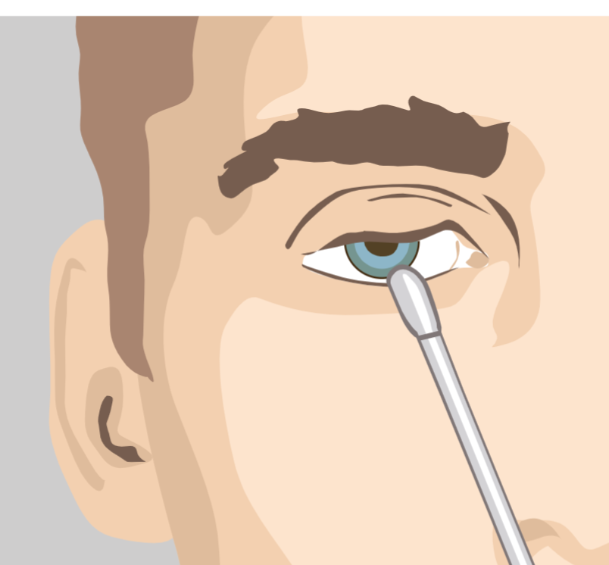
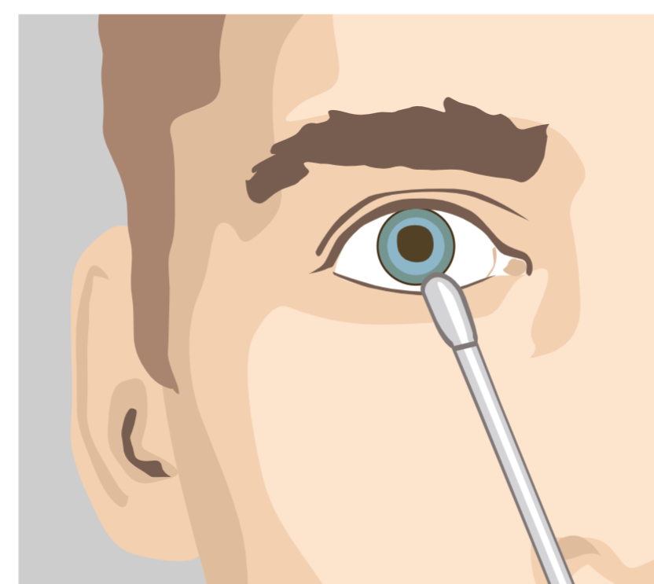
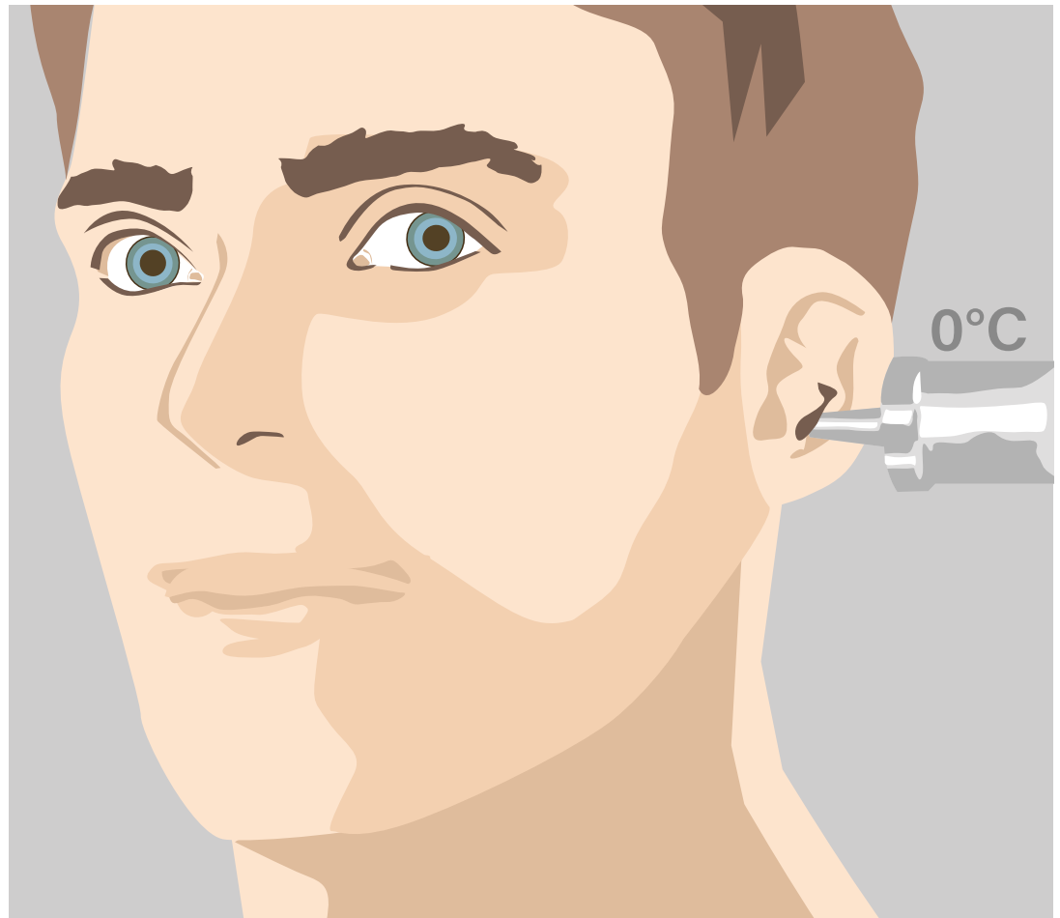
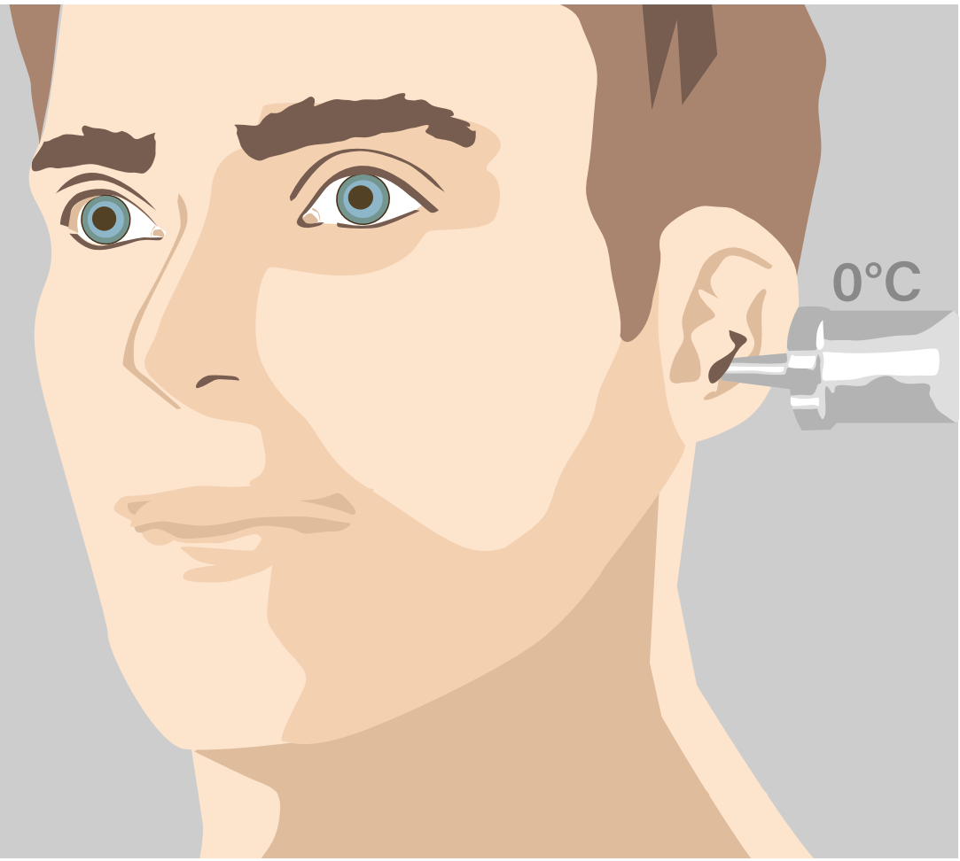
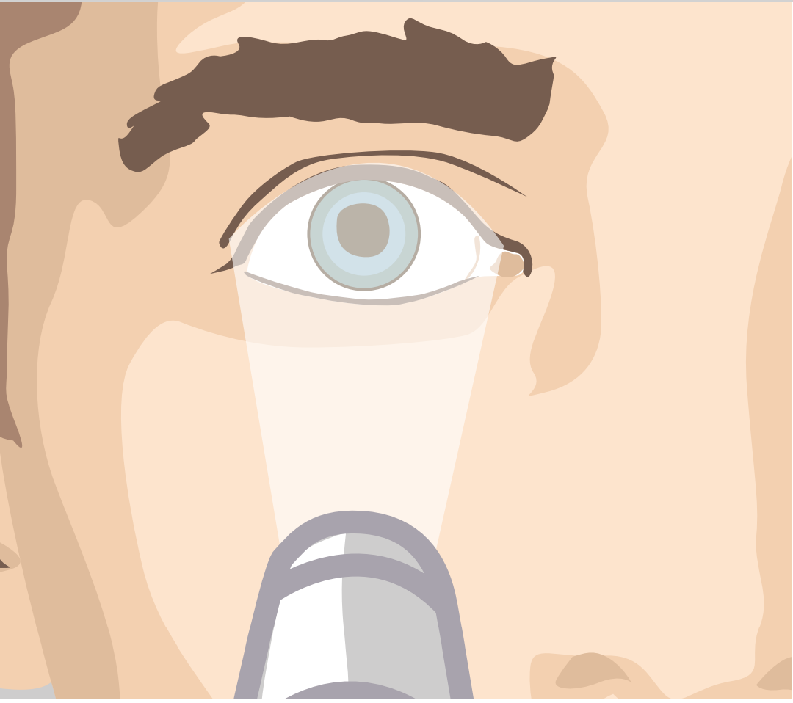
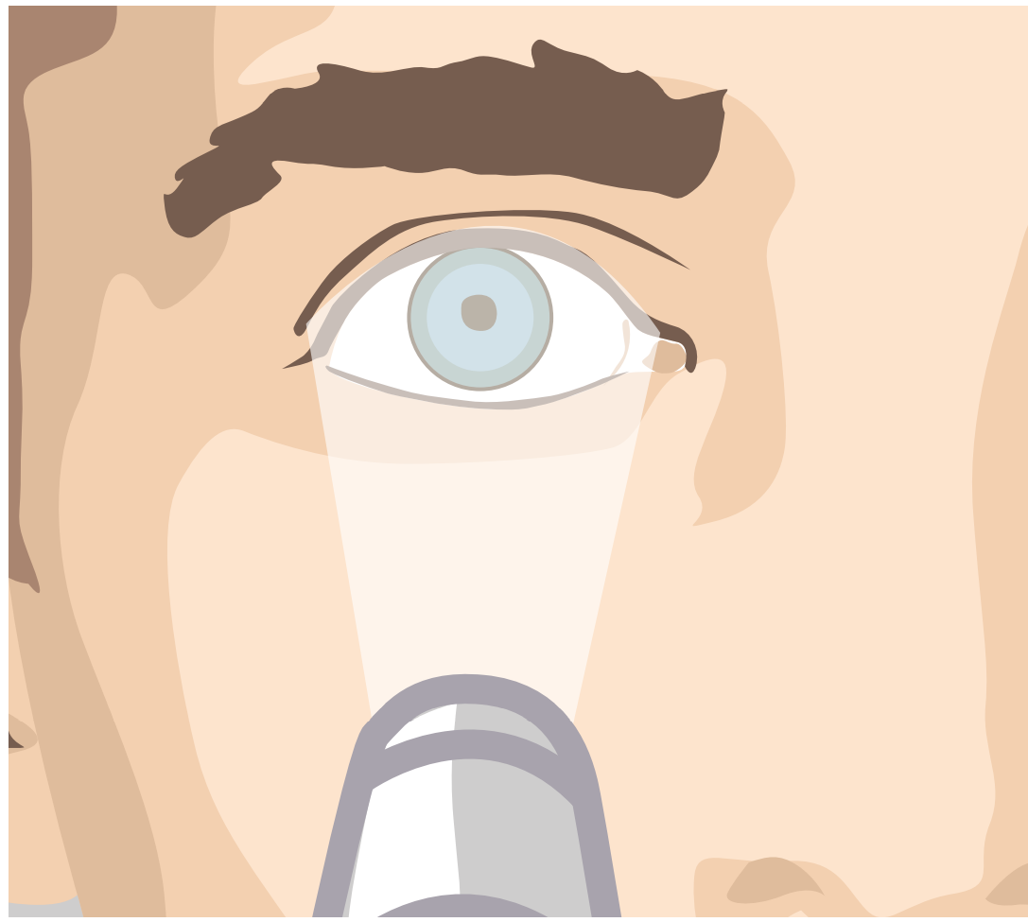
Procedure
Process of organ donation
Diagnosis of brain death
Carried out by two impartial specialists who are not involved in the transplant procedure
7 clinical signs: brainstem reflex test
Examples of normal and pathological reactions
Corneal reflex
Vestibulo-ocular reflex
Mydriatic test

Slide 33
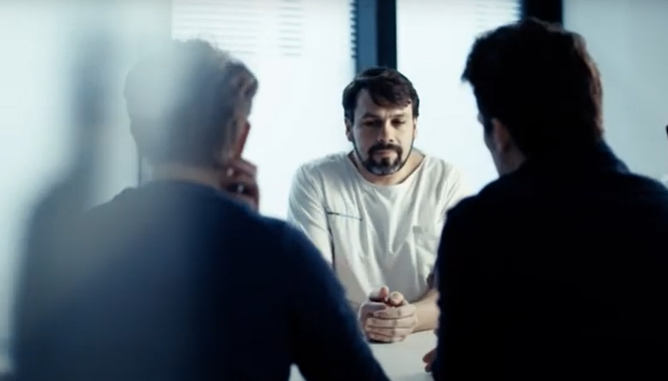
Procedure
Process of organ donation
Consent
First approach: informed of brain death/life-threatening condition
Second approach: question of wishes of the deceased regarding organ donation
No urgency for the decision

Slide 34
Procedure
Process of organ donation
Discussion with relatives
Away from the patient’s bed
Announcement of death or hopeless diagnosis and change of treatment
Organ and tissue donation discussed
Time frame
Maximum of 48 hours between the change of treatment and brain death (otherwise DCD donation)
Organ procurement must be completed within 72 hours of the diagnosis of brain death

Slide 35
Procedure
Process of organ donation
Swisstransplant
Permission given
Brain death/change of treatment
Data entry of the deceased:
Case history
Results
Laboratory tests
Imagery

Slide 36
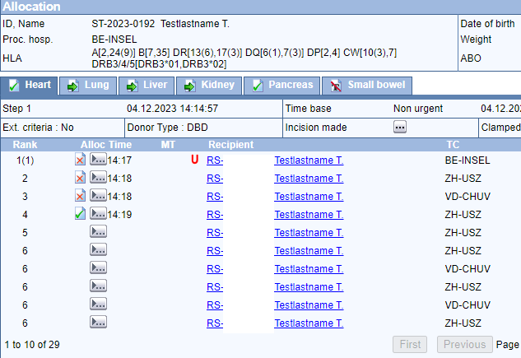
Procedure
Process of organ donation
Waiting list/ranking
Data entry in the SOAS (Swiss Organ Allocation System)
Swisstransplant – calculation of the ranking of the potential recipients using SOAS software
The ranking list depends on donor characteristics
SOAS

Slide 37
Procedure
Process of organ donation
Attribution
The ranking list is calculated on the basis of the distribution rules of the law using an algorithm
Swisstransplant offers organs to centres for potential recipients
1
2
3
4
Medical urgency
Medical
benefit
Priority
(children/blood
Group)
Waiting
time

Slide 38
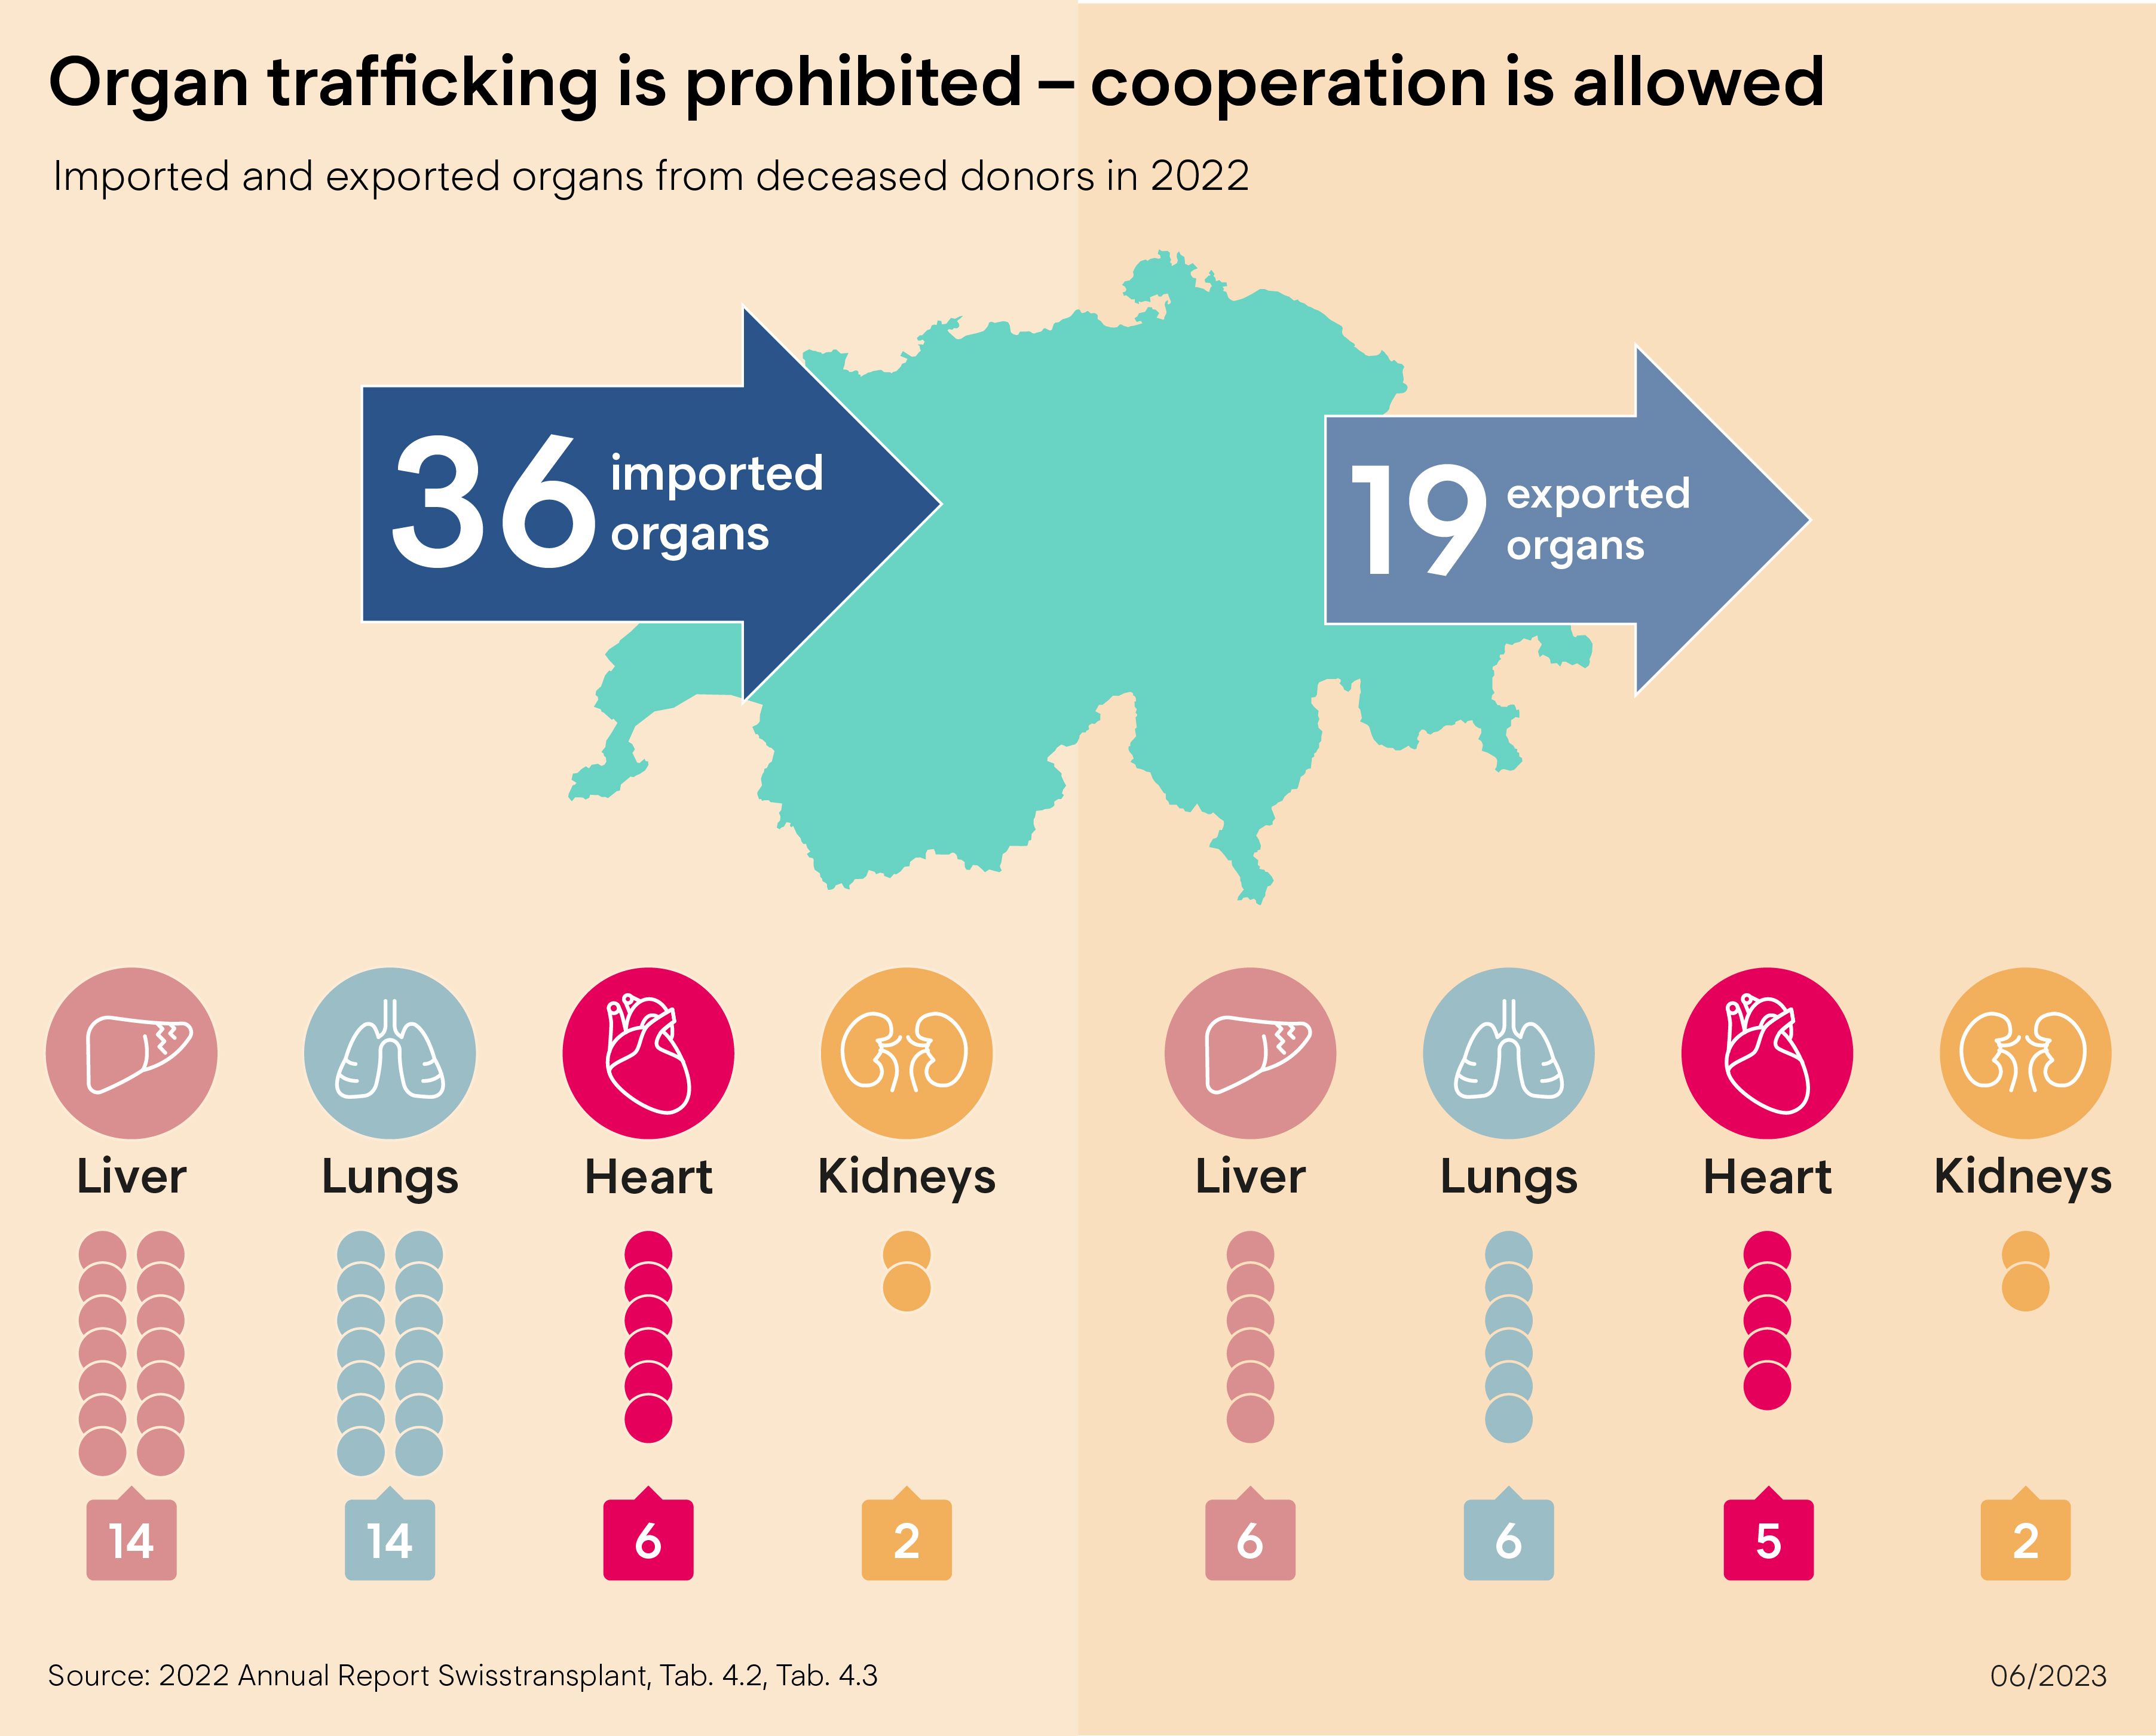
Procedure
Process of organ donation
Attribution
Cooperation with European
allocation centres
BE
LS
ZH
SG
GE
ABM

Slide 39
Procedure
Process of organ donation
Planning
Timing: everything at the right time and place
Limiting factors:
Availability of operating rooms
Anaesthesia team, procurement team
Hospital routine
Flight time, workload, weather

Slide 40
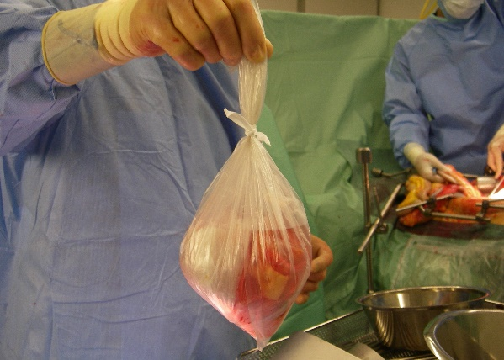
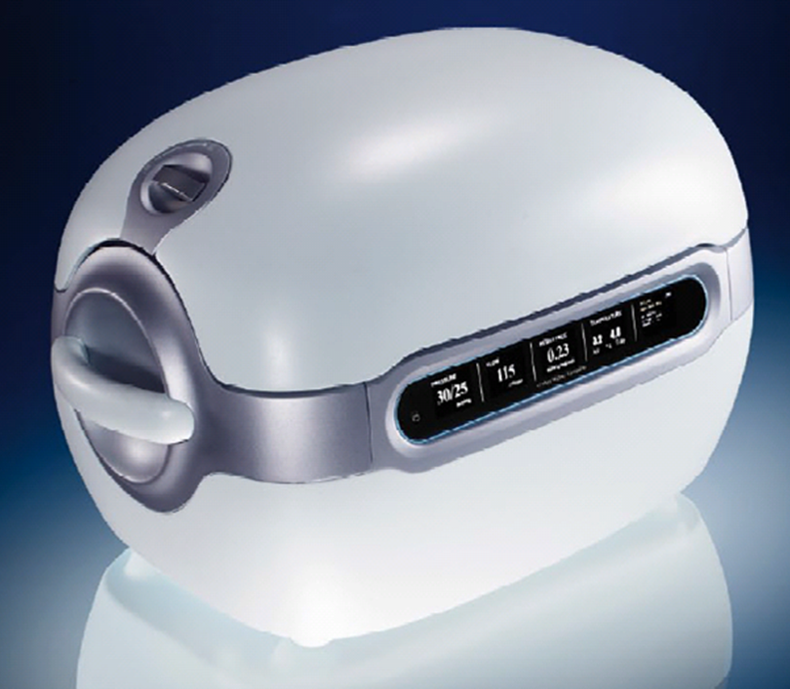
Procedure
Process of organ donation
Procurement
Organs procured by surgeons from donor hospital
Correct conditioning of organs
Accompanied or unaccompanied transport of organs to recipient hospital

Slide 41
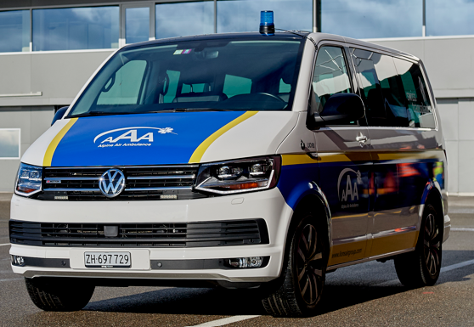
Procedure
Process of organ donation
Transport
Taxi, ambulance, helicopter, jet
Ischemia time: the time interval between the interruption of the organ’s blood supply in the donor’s body and the resumption of the organ’s blood flow in the recipient’s body
Heart
Lungs/liver/pancreas
Kidneys
3−4 h
6−8 h
24 h

Slide 42
Procedure
Process of organ donation
Transplantation
Preliminary examinations carried out on the recipient
Transplantation carried out in transplant centre
After a successful operation, the transplanted organ regains its function.

Slide 43
Organ recipients
After organ donation
Improved quality of life
Lifetime medication (immunosuppression)
Prolongation of life
Possibility to write an anonymous thank you letter to the donor family
Lara B., liver transplant recipient

Slide 44
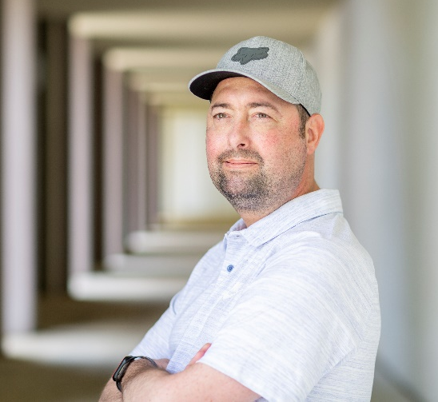
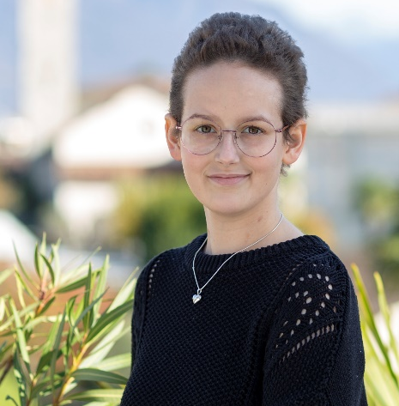
Organ recipients
Ambassadors
Renata, heart recipient
Sébastien, heart recipient
Maurice, kidney recipient
Lorena, heart recipient
Aline, heart recipient
Samuel, liver recipient

Slide 45
Tissue donation
Process of organ donation
In case of death in hospital
24−48 hours after death
Consent
Categories on donor card
Cornea
Cardiac valves, large blood vessels
Vessels
Corneal transplantation after eye injury, corneal infections (keratitis)

Slide 46
Saying goodbye
Process of organ donation
Possibility for relatives to say goodbye to the deceased
Funeral organized according to the wishes of the deceased and his or her relatives
Last respects, cremation or burial possible
Most important principle: dignified treatment both before
and after the organ removal.
Quelle: Pixabay
Source: Pixabay

Slide 47
Organ donation in Switzerland
A decision for life
74 %
In favour
43 %
Decision not held
56 % refusal of relatives
60.2% Yes to the extended opt-out solution
GFS Bern (2019), GFS Bern (2019), SwissPOD (2022)

Slide 48
Questions
05
Swisstransplant
Thanks and conclusion

Slide 49
Thank you!
Swisstransplant Effingerstrasse 1
Postfach CH-3011 Bern Tel. +41 58 123 80 00
www.swisstransplant.org info@swisstransplant.org
© Swisstransplant
Ana, lung recipient

